Slide 1
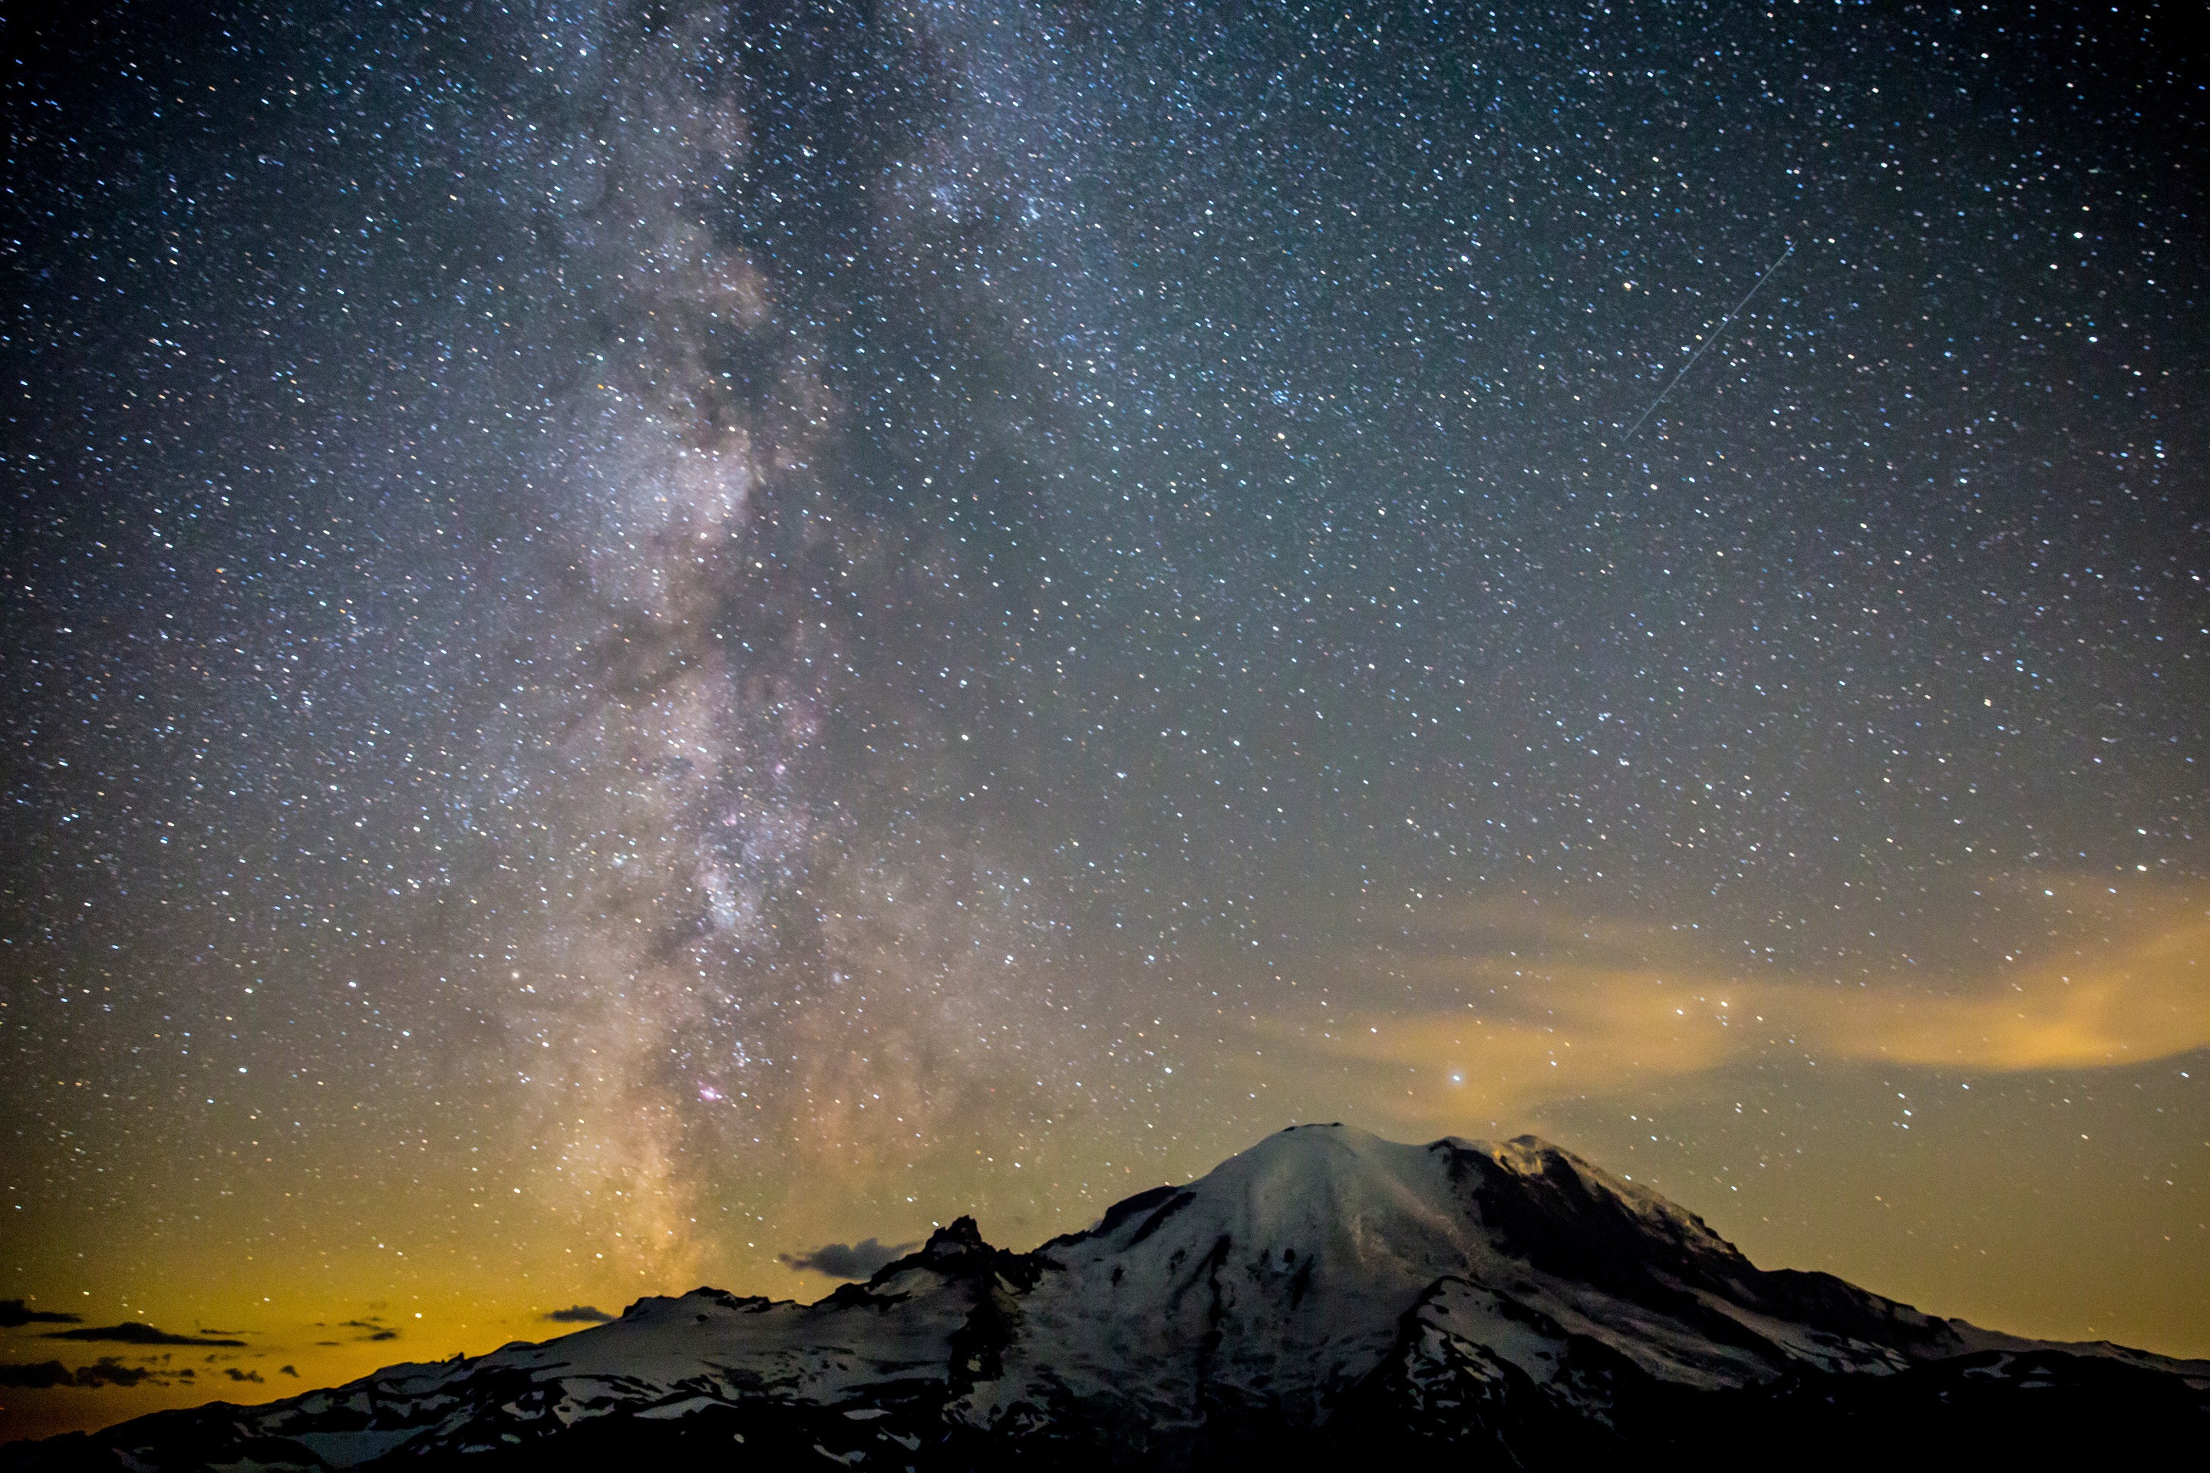

Modeling of
Aeroservoelastic Systems
Anthony Su
11/30/2023
Notes:
Name: Anthony Su
Master’s student at the Aero+Astro department here at the University of Washington
Advisor: Professor Eli Livne
Thesis: Modeling of Aeroservoelastic Systems

Slide 2
Agenda
Overview
FEM & GVT
Mathematical Model
Wind Tunnel Testing
Model Tuning & Optimization
Conclusion
Notes:
AGENDA:
overview
FEM & GVT
math model

Slide 3
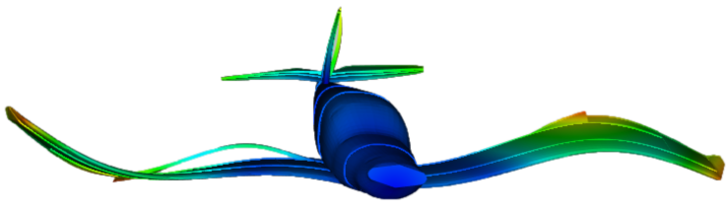
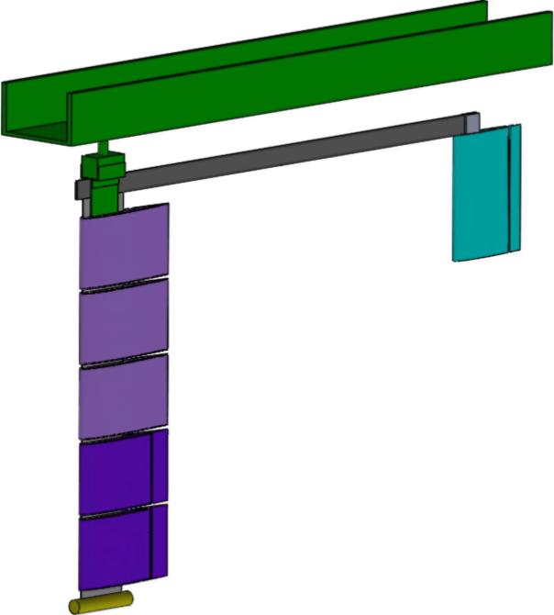
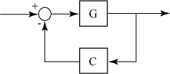
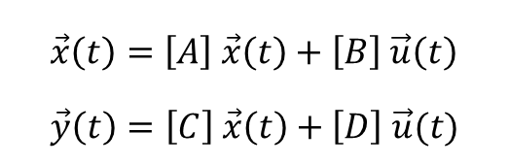
Overview
AEROSERVO-
ELASTICITY
MARGE
MODELING
Structural Dynamics
Aerodynamics
Controls
Model for Aeroelastic Response to Gust Excitation¹
Physics-based model
Required for active control
$$\vec{x}\left(t\right)=\left[A\right] \vec{x}\left(t\right)+\left[B\right] \vec{u}\left(t\right) \\ \vec{y}\left(t\right)=\left[C\right] \vec{x}\left(t\right)+\left[D\right] \vec{u}(t)$$
https://www.m4-engineering.com/wp-content/uploads/2020/04/pynastran-2.png
Notes:
Aeroservoelasticity
structural dynamics, aerodynamics, and controls
important because energy-efficient aircraft have long, slender wings which are flexible
the most flexible wings must actively counteract bending and twisting in real-time
MLA, GLA, and flutter suppression
MARGE
MARGE is the test article that is modeled and tested in this project
short for Model for Aeroelastic Response to Gust Excitation
Modeling
The objective of this project was to synthesize a physics-based state-space model of MARGE
Physics-based “grey-box” models are (in theory) more interpretable and generalizable than traditional black-box system identification methods
This model can then be used for control design to do the aforementioned things (MLA, GLA, flutter suppression)

Slide 4
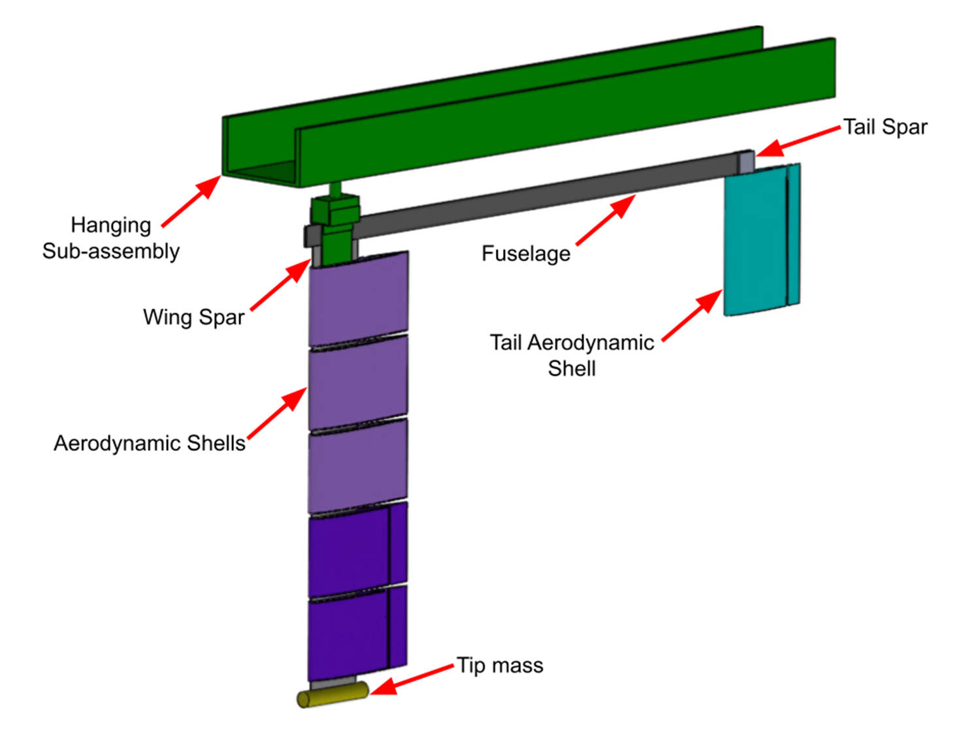
Overview
MARGE
Model for Aeroelastic Response to Gust Excitation¹
Low-cost
Highly flexible
Rotates freely in pitch
Notes:
MARGE: model for aeroelastic response to gust excitation
Designed and built several years ago, see [Quenzer et. al. 2019]

Slide 5
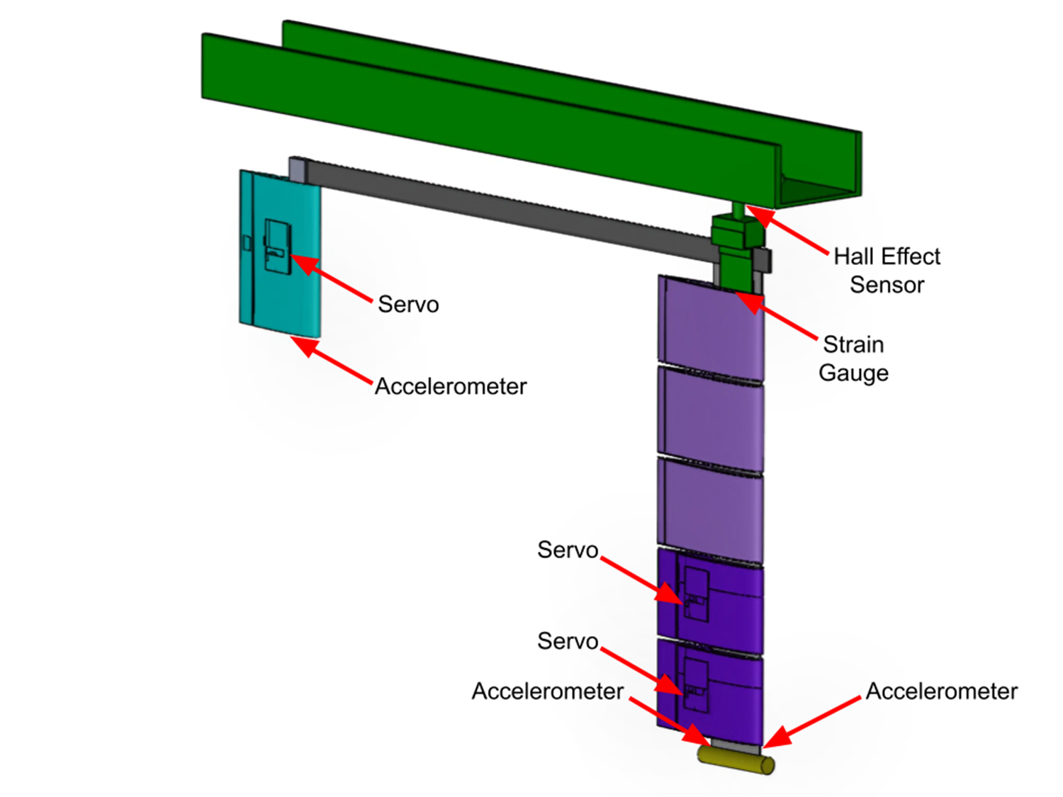
Overview
MARGE
Model for Aeroelastic Response to Gust Excitation¹
Low-cost
Highly flexible
Rotates freely in pitch
5 on-board sensors
3 on-board actuators
Notes:
<insert>

Slide 6
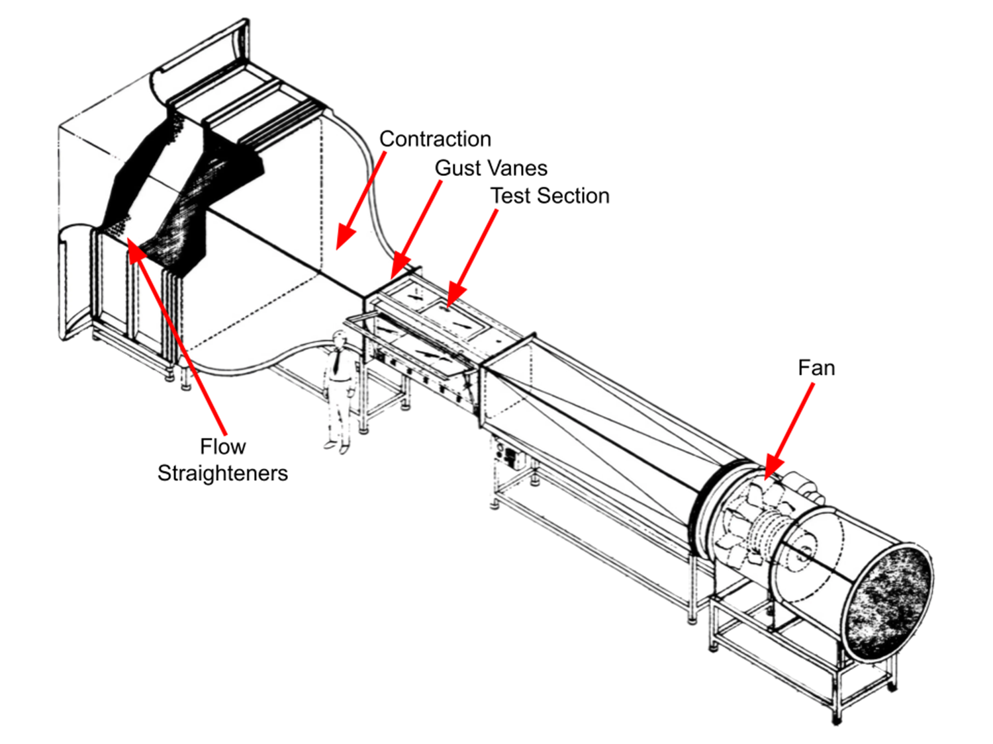
Overview
MARGE
Model for Aeroelastic Response to Gust Excitation¹
Low-cost
Highly flexible
Rotates freely in pitch
5 on-board sensors
3 on-board actuators
3x3 Wind Tunnel
Twin controllable upstream gust vanes
Notes:
MARGE is designed to be tested in the UW 3x3 wind tunnel
Wind blows from top left to bottom right in this image
Upstream of where MARGE is mounted are two gust vanes which can create unsteady flow fields around MARGE

Slide 7




FEM & GVT
Why?
Need structural dynamic modal information
Existing FEM was outdated

Slide 8
FEM & GVT
NASTRAN FEM
Spars: Linear beam elements
Fuselage: Linear beam elements
Panels: Rigid elements
Notes:
<insert>
disclaimer: I didn’t make the NASTRAN model

Slide 9
FEM & GVT
NASTRAN FEM
Spars: Linear beam elements
Fuselage: Linear beam elements
Panels: Rigid
Vanes: Rigid
Tunnel: Rigid
Doublet-lattice theory aerodynamics
Spline interpolation
Notes:
<insert>

Slide 10
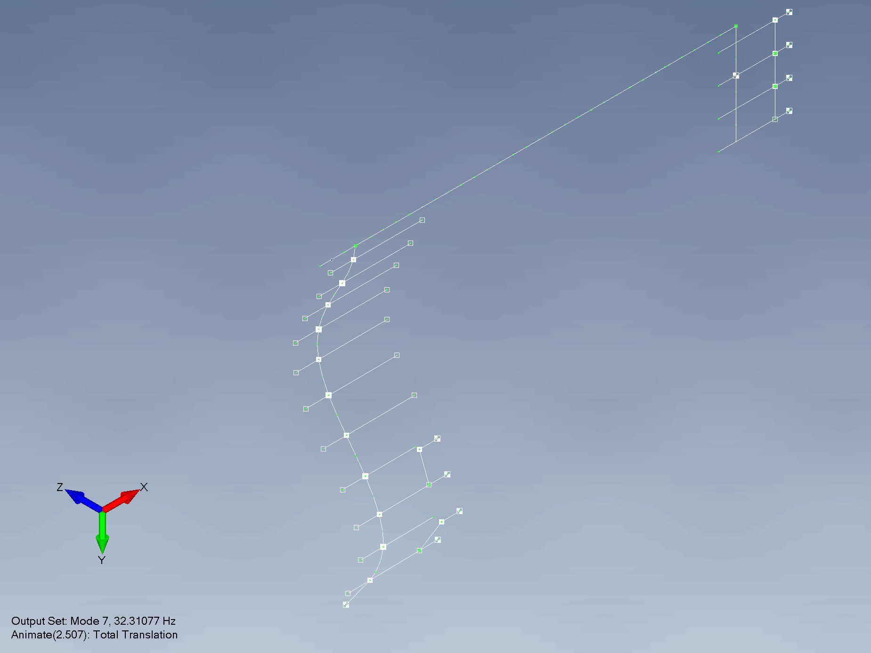
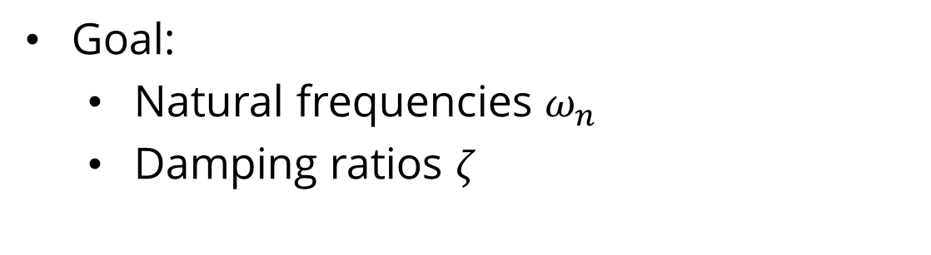
FEM & GVT
GVT
Goal:
Natural frequencies $ω_{n}$
Damping ratios $ζ$
Notes:
<insert>

Slide 11
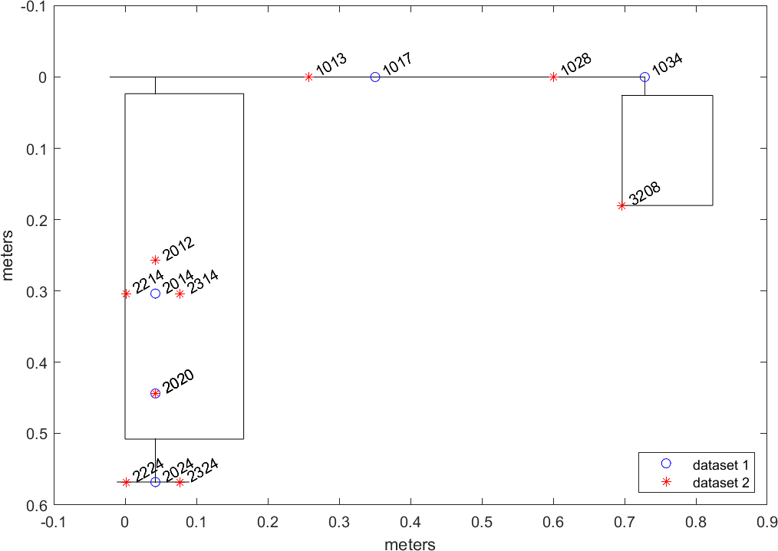
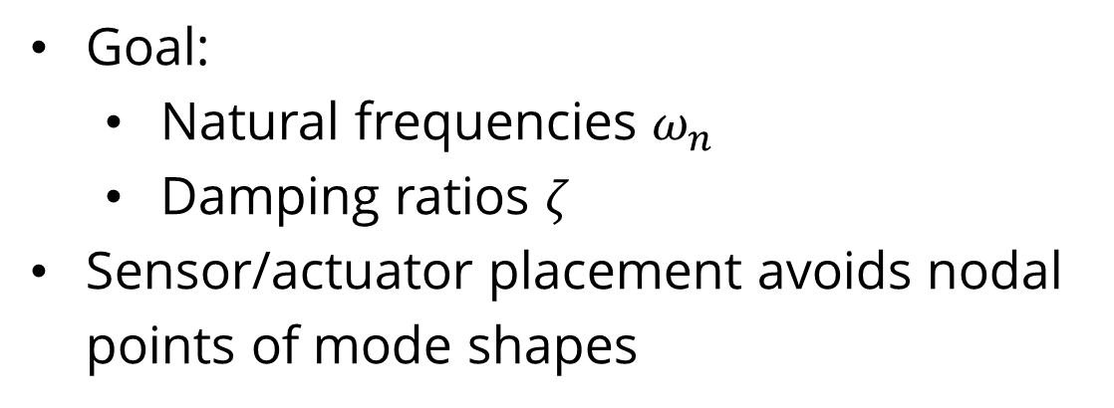
FEM & GVT
GVT
Goal:
Natural frequencies $ω_{n}$
Damping ratios $ζ$
Sensor/actuator placement avoids nodal points of mode shapes
Notes:
<insert>

Slide 12
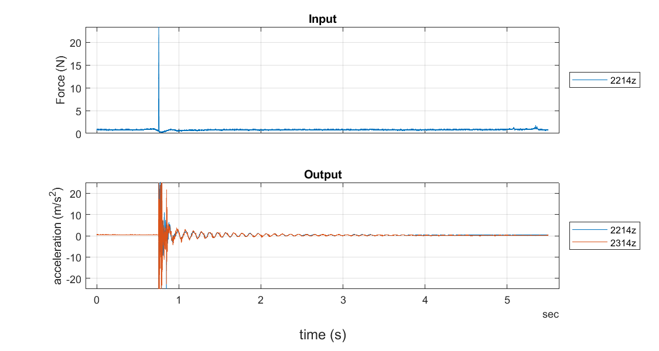
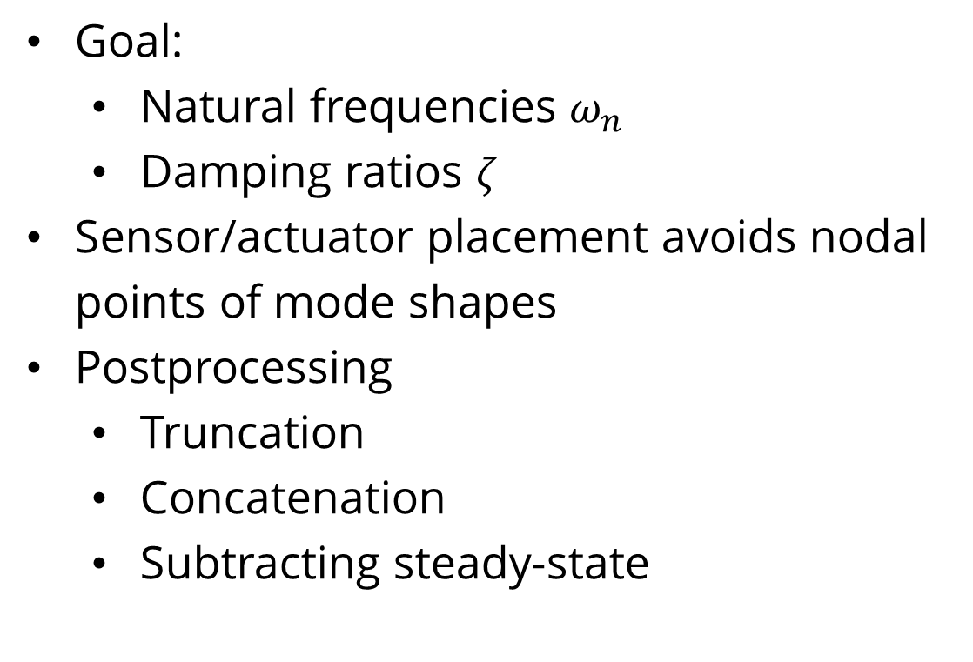
FEM & GVT
GVT
Goal:
Natural frequencies $ω_{n}$
Damping ratios $ζ$
Sensor/actuator placement avoids nodal points of mode shapes
Postprocessing
Truncation
Concatenation
Subtracting steady-state
Notes:
<insert>

Slide 13
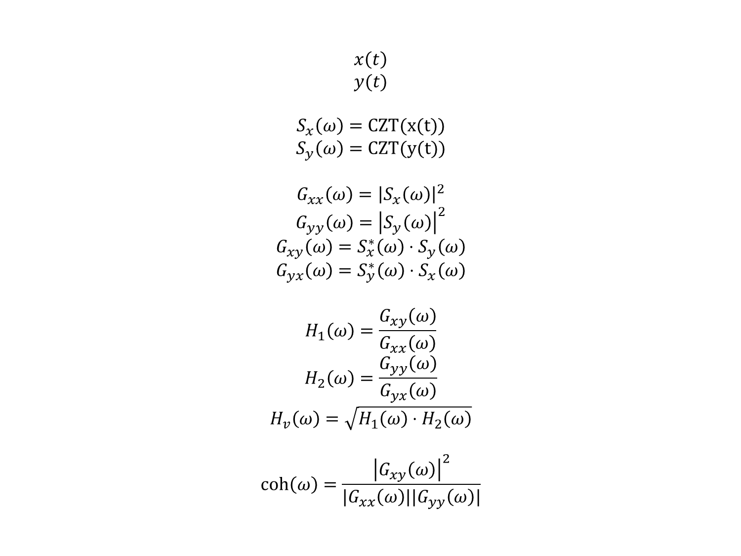
FEM & GVT
GVT
$$x\left(t\right)$$
$$y(t)$$
$$S_{x}\left(ω\right)=\text{CZT}\text{(}\text{x}\text{(}\text{t}\text{))}$$
$$S_{y}\left(ω\right)=\text{CZT}\text{(}\text{y}\text{(}\text{t}\text{))}$$
$$G_{xx}\left(ω\right)={\left|S_{x}\left(ω\right)\right|}^{2}$$
$$G_{yy}\left(ω\right)={\left|S_{y}\left(ω\right)\right|}^{2}$$
$$G_{xy}\left(ω\right)=S_{x}^{∗}\left(ω\right)⋅S_{y}\left(ω\right)$$
$$G_{yx}\left(ω\right)=S_{y}^{∗}\left(ω\right)⋅S_{x}\left(ω\right)$$
$$H_{1}\left(ω\right)=\frac{G_{xy}\left(ω\right)}{G_{xx}\left(ω\right)}$$
$$H_{2}\left(ω\right)=\frac{G_{yy}\left(ω\right)}{G_{yx}\left(ω\right)}$$
$$H_{v}\left(ω\right)=\sqrt{H_{1}\left(ω\right)⋅H_{2}\left(ω\right)}$$
$$\text{coh}\left(ω\right)=\frac{{\left|G_{xy}\left(ω\right)\right|}^{2}}{|G_{xx}\left(ω\right)||G_{yy}\left(ω\right)|}$$
Transform to frequency domain
Chirp Z-transform
Correlation functions
Frequency response function (FRF)
Coherence

Slide 14
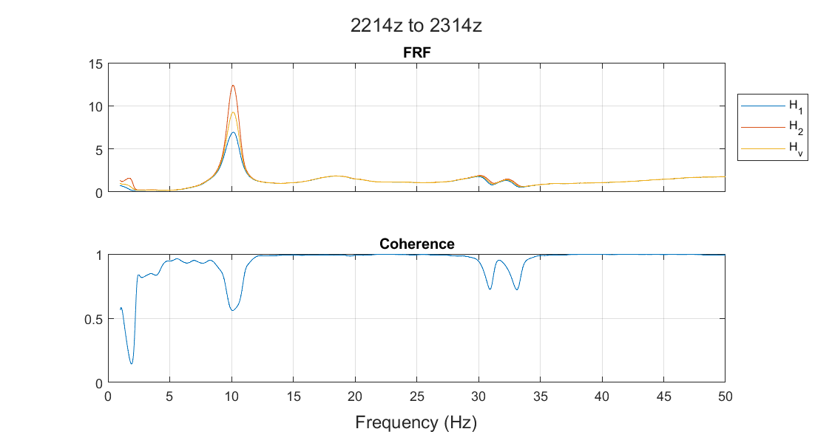
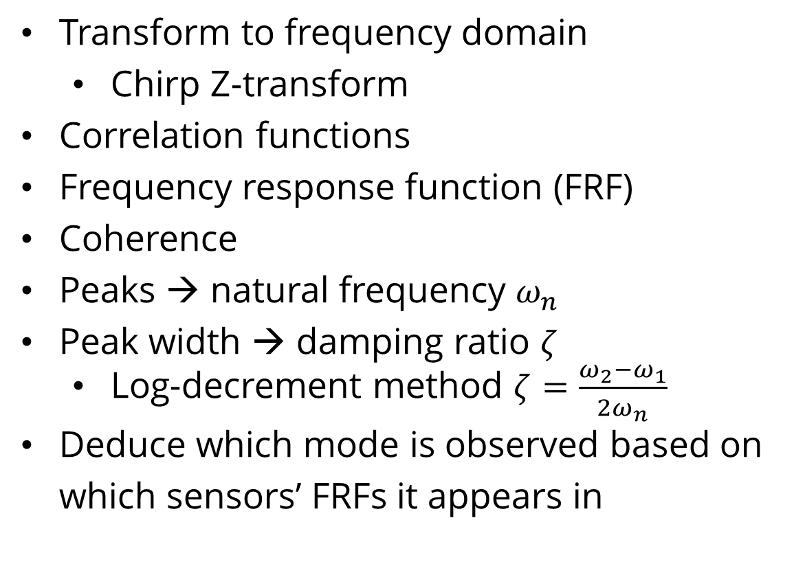
FEM & GVT
GVT
example FRF
Transform to frequency domain
Chirp Z-transform
Correlation functions
Frequency response function (FRF)
Coherence
Peaks → natural frequency $ω_{n}$
Peak width → damping ratio $ζ$
Log-decrement method $ζ=\frac{ω_{2}−ω_{1}}{2ω_{n}}$
Deduce which mode is observed based on which sensors’ FRFs it appears in
Notes:
<insert>

Slide 15
FEM & GVT
GVT
Adjusted bending and torsional stiffness of FEM elements
Torsional mode is captured
Old | Updated | Experiment | Description
0 | 0 |  | pitching
1.454401 | 1.44397 | 1.422 | wing bending 1
10.51099 | 10.48667 | 10.142 | wing bending 2
 | 19.1997 | 18.094 | wing twisting 1
23.13519 | 21.94804 | 19.893 | fuselage in-plane bending 1
17.81394 | 16.63828 | 19.897 | fuselage bending 1
32.33148 | 32.31077 | 32.545 | wing bending 3
 | - | 51.706 | wing twisting 2
66.02579 | 66.01089 | 60.482 | wing bending 4
69.7988 | 69.29826 |  | wing in-plane bending 1
62.68383 | 60.85218 | 74.521 | fuselage bending 2
Notes:
<insert>

Slide 16
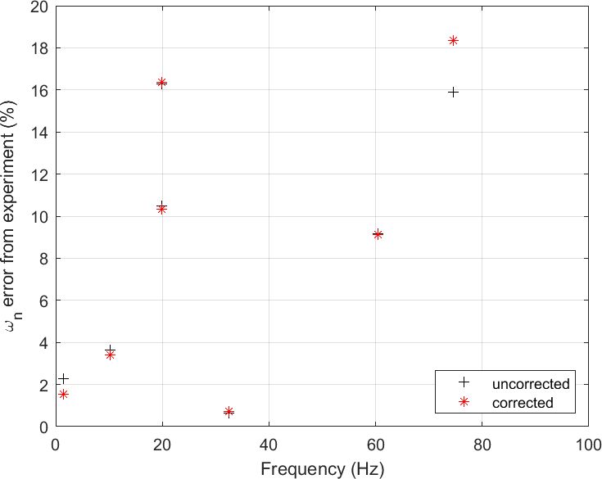
FEM & GVT
GVT
Adjusted bending and torsional stiffness of FEM elements
Torsional mode is captured
FEM matches experiment better
Notes:
<insert>

Slide 17

Mathematical
Model
$$\vec{x}\left(t\right)=\left[A\right] \vec{x}\left(t\right)+\left[B\right] \vec{u}\left(t\right)$$
$$\vec{y}\left(t\right)=\left[C\right] \vec{x}\left(t\right)+\left[D\right] \vec{u}(t)$$

Slide 18
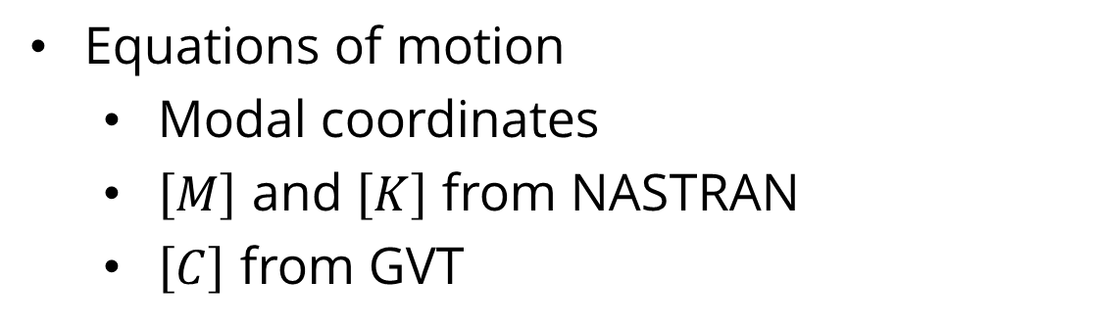
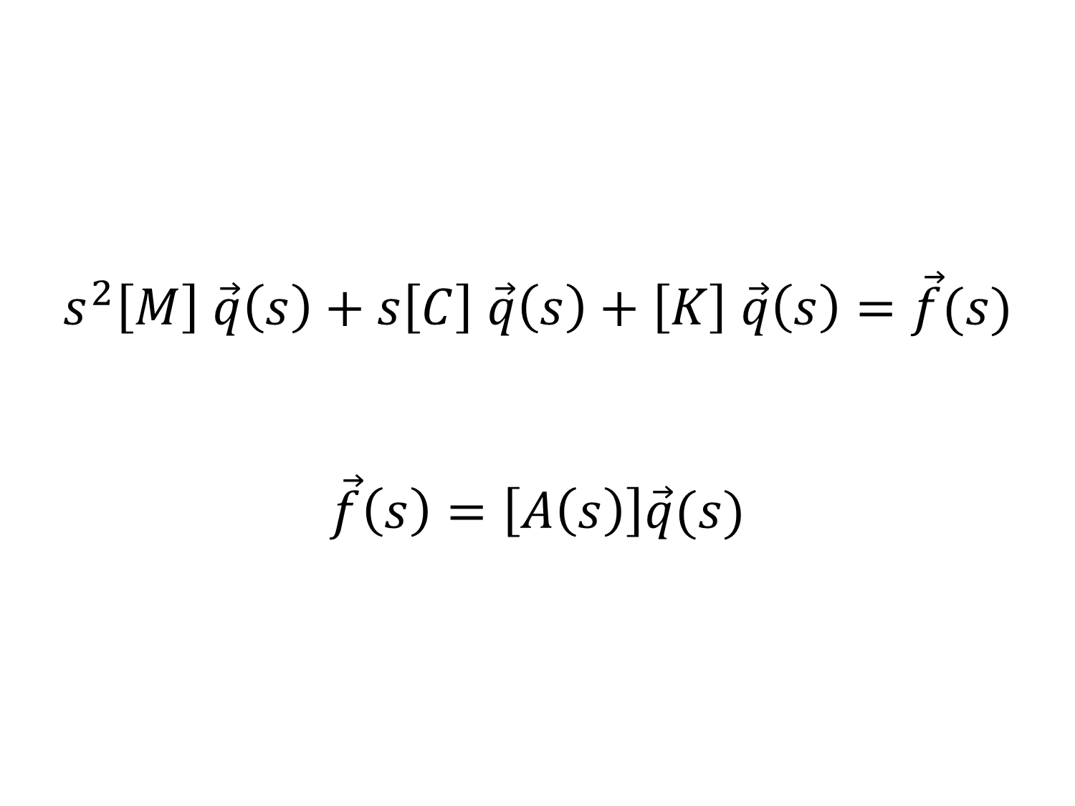
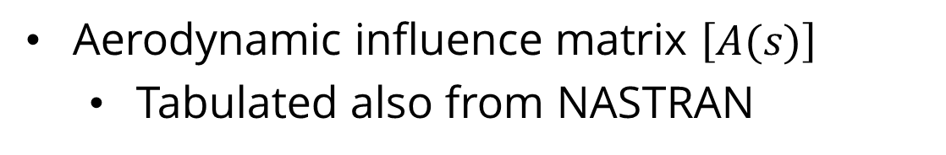
Math Model
Structural Dynamics
$$s^{2}\left[M\right] \vec{q}\left(s\right)+s\left[C\right] \vec{q}\left(s\right)+\left[K\right] \vec{q}\left(s\right)=\vec{f}(s)$$
$$\vec{f}\left(s\right)=\left[A\left(s\right)\right]\vec{q}(s)$$
Equations of motion
Modal coordinates
$\left[M\right]$ and $\left[K\right]$ from NASTRAN
$\left[C\right]$ from GVT
Aerodynamics
Aerodynamic influence matrix $\left[A(s)\right]$
Tabulated also from NASTRAN
Notes:
<insert>

Slide 19
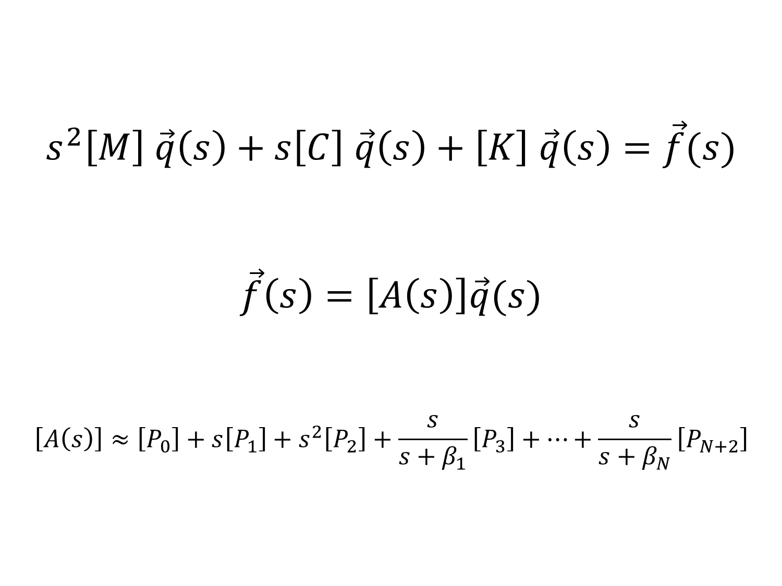
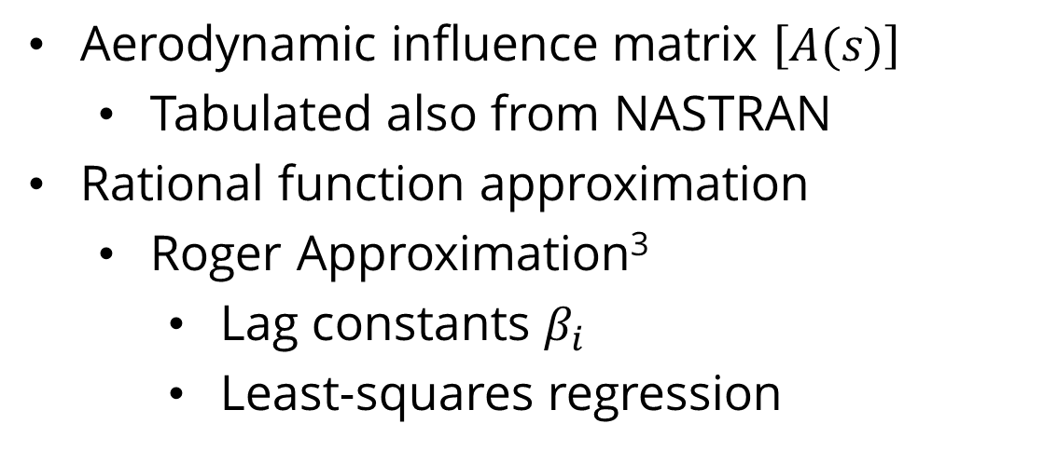
Math Model
Structural Dynamics
$$s^{2}\left[M\right] \vec{q}\left(s\right)+s\left[C\right] \vec{q}\left(s\right)+\left[K\right] \vec{q}\left(s\right)=\vec{f}(s)$$
$$\vec{f}\left(s\right)=\left[A\left(s\right)\right]\vec{q}(s)$$
$$\left[A\left(s\right)\right]≈\left[P_{0}\right]+s\left[P_{1}\right]+s^{2}\left[P_{2}\right]+\frac{s}{s+β_{1}}\left[P_{3}\right]+…+\frac{s}{s+β_{N}}\left[P_{N+2}\right]$$
Equations of motion
Modal coordinates
$\left[M\right]$ and $\left[K\right]$ from NASTRAN
$\left[C\right]$ from GVT
Aerodynamics
Aerodynamic influence matrix $\left[A(s)\right]$
Tabulated also from NASTRAN
Rational function approximation
Roger Approximation³
Lag constants $β_{i}$
Least-squares regression
Notes:
<insert>

Slide 20
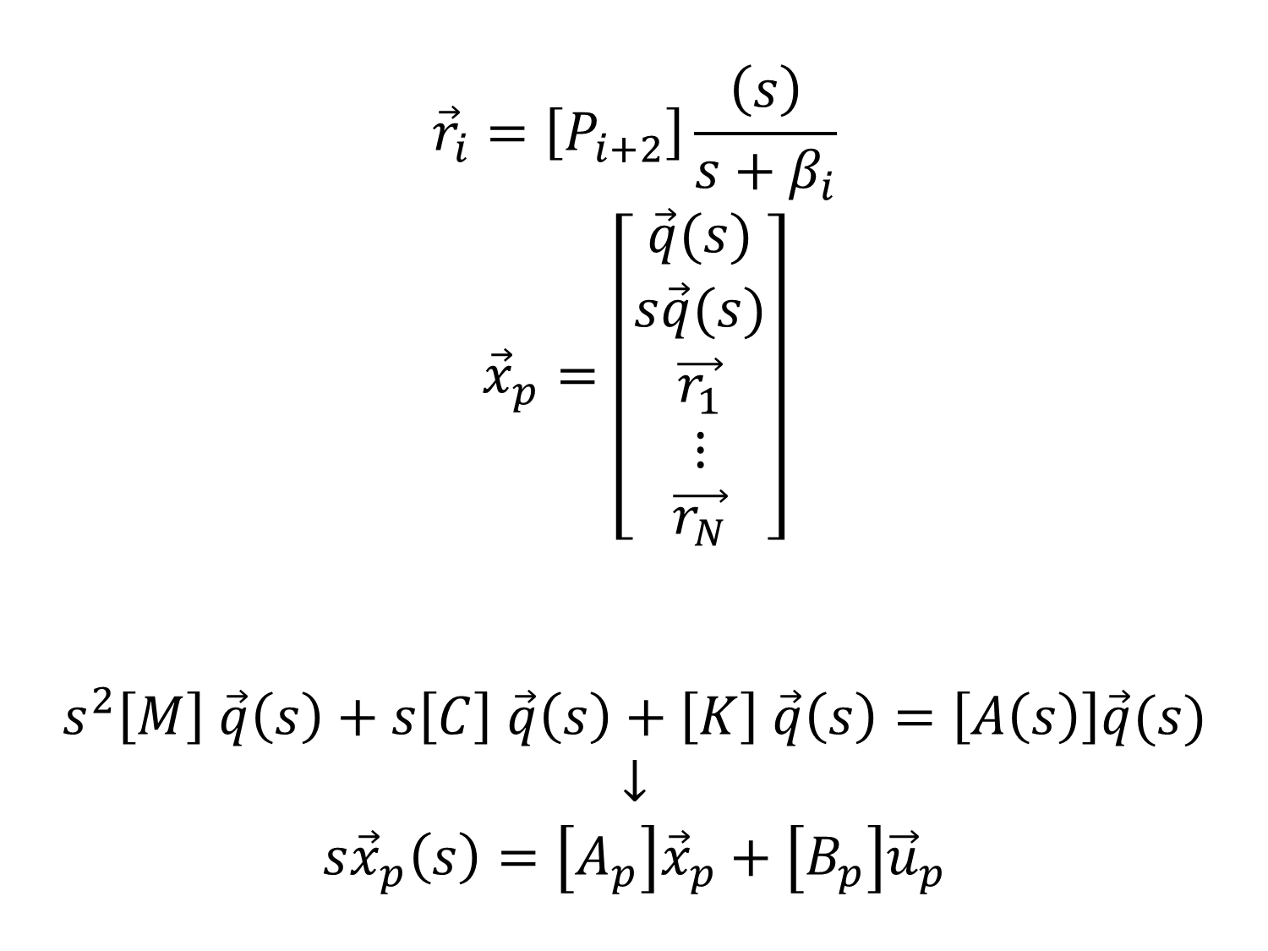
Math Model
Plant Dynamics
$${\vec{r}}_{i}=\left[P_{i+2}\right]\frac{\left(s\right)}{s+β_{i}}$$
$${\vec{x}}_{p}=\left[\begin{aligned}\vec{q}(s) \\ s\vec{q}(s) \\ \vec{r_{1}} \\ ⋮ \\ \vec{r_{N}}\end{aligned}\right]$$
$$s^{2}\left[M\right] \vec{q}\left(s\right)+s\left[C\right] \vec{q}\left(s\right)+\left[K\right] \vec{q}\left(s\right)=\left[A\left(s\right)\right]\vec{q}(s)$$
$$↓$$
$$s{\vec{x}}_{p}\left(s\right)=\left[A_{p}\right]{\vec{x}}_{p}+\left[B_{p}\right]{\vec{u}}_{p}$$
State vector
position
velocity
lag terms
Reduce order of equations of motion to first-order → state-space model
Notes:
<insert>

Slide 21
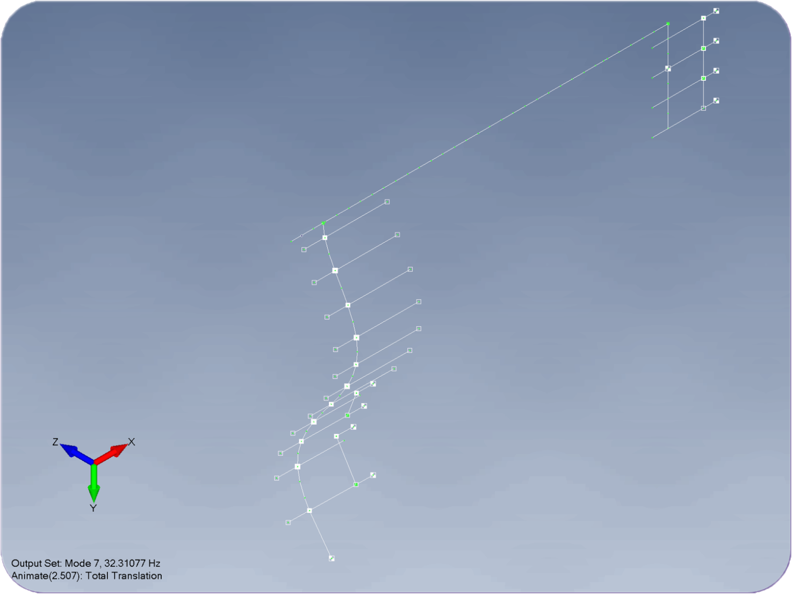
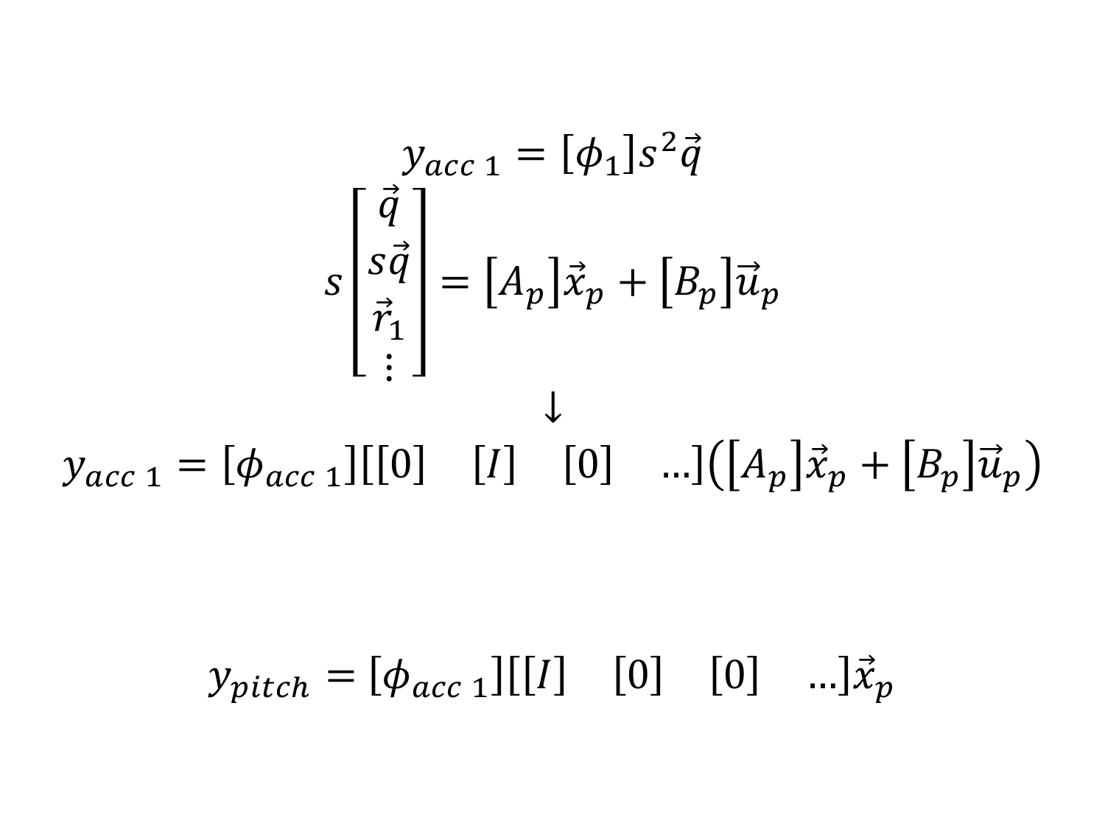
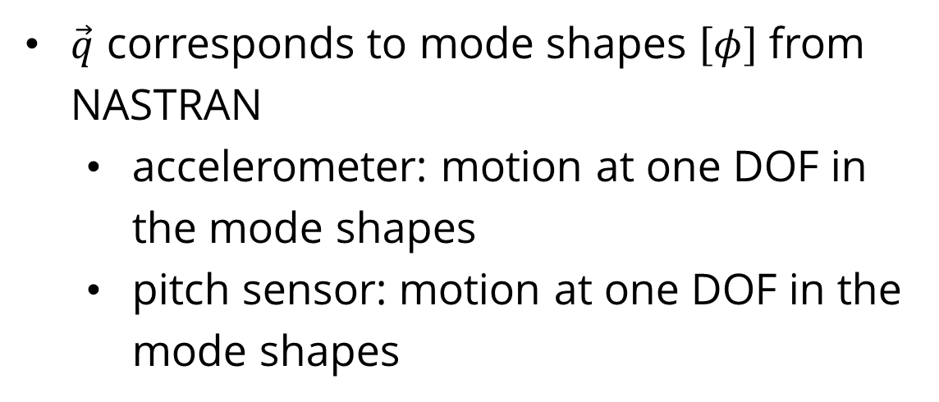
Math Model
Plant Output
$$y_{acc 1}=\left[φ_{1}\right]s^{2}\vec{q}$$
$$s\left[\begin{aligned}\vec{q} \\ s\vec{q} \\ {\vec{r}}_{1} \\ ⋮\end{aligned}\right]=\left[A_{p}\right]{\vec{x}}_{p}+\left[B_{p}\right]{\vec{u}}_{p}$$
$$↓$$
$$y_{acc 1}=\left[φ_{acc 1}\right]\left[\begin{matrix}\left[0\right] & \left[I\right] & \left[0\right] & …\end{matrix}\right]\left(\left[A_{p}\right]{\vec{x}}_{p}+\left[B_{p}\right]{\vec{u}}_{p}\right)$$
$y_{pitch}=$ $\left[φ_{acc 1}\right]\left[\begin{matrix}\left[I\right] & \left[0\right] & \left[0\right] & …\end{matrix}\right]{\vec{x}}_{p}$
$\vec{q}$ corresponds to mode shapes $\left[φ\right]$ from NASTRAN
accelerometer: motion at one DOF in the mode shapes
pitch sensor: motion at one DOF in the mode shapes
Notes:
<insert>

Slide 22
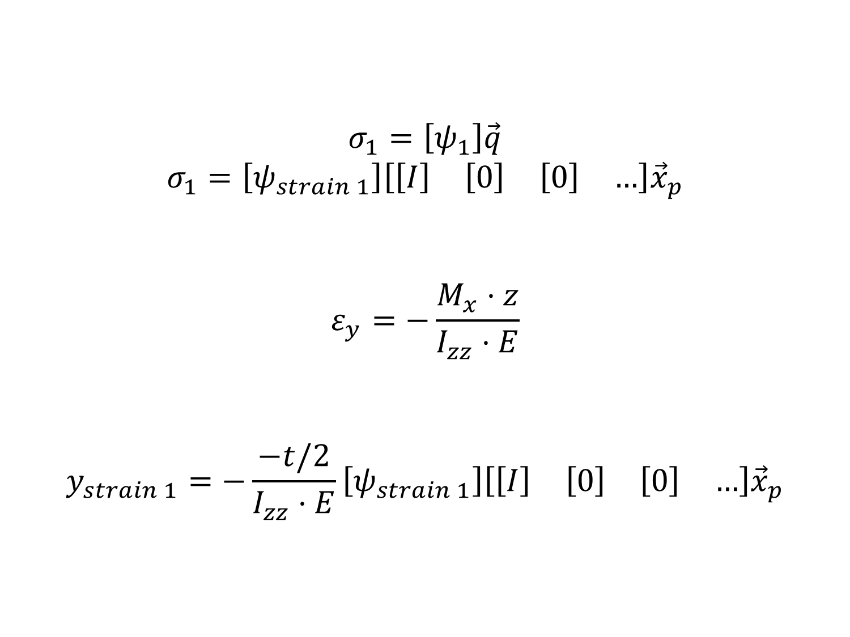
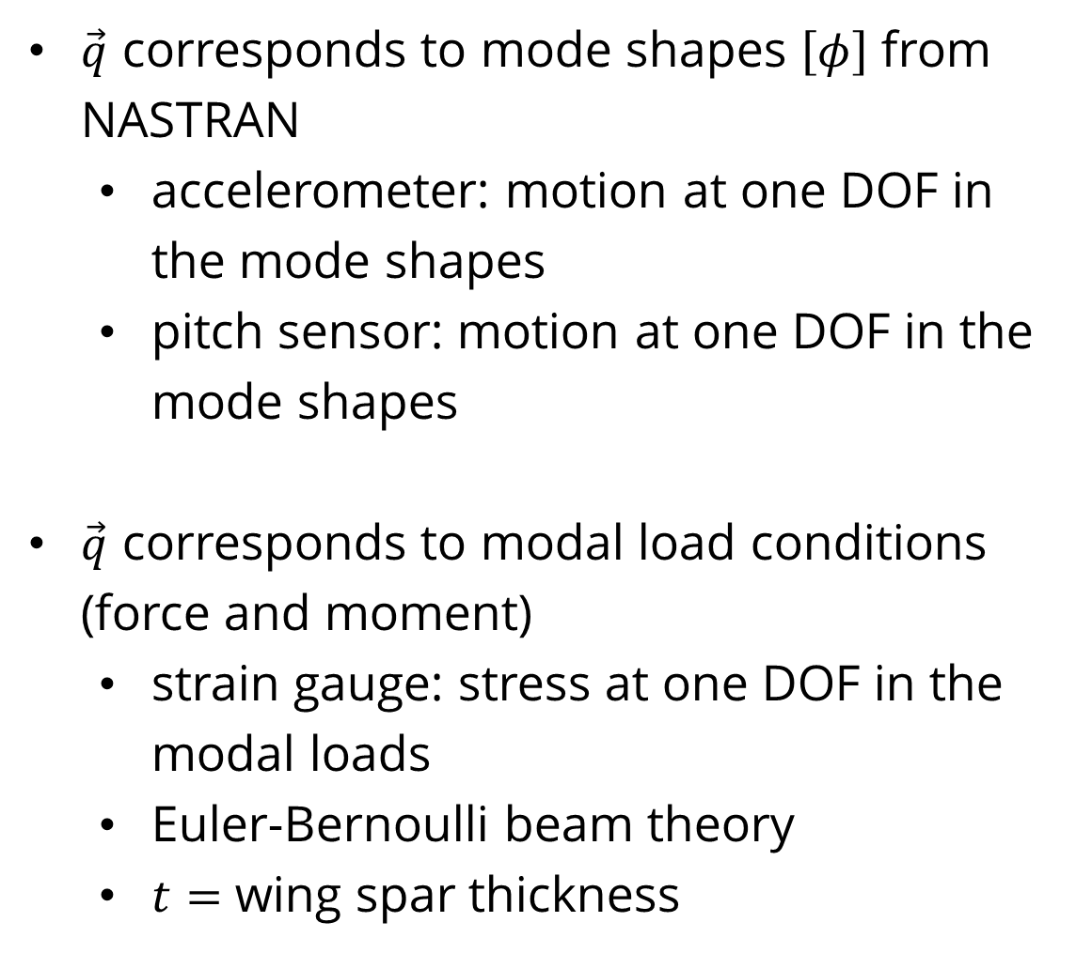
Math Model
Plant Output
$$σ_{1}=\left[ψ_{1}\right]\vec{q}$$
$$σ_{1}=\left[ψ_{strain 1}\right]\left[\begin{matrix}\left[I\right] & \left[0\right] & \left[0\right] & …\end{matrix}\right]{\vec{x}}_{p}$$
$$ε_{y}=−\frac{M_{x}⋅z}{I_{zz}⋅E}$$
$$y_{strain 1}=−\frac{−t/2}{I_{zz}⋅E}\left[ψ_{strain 1}\right]\left[\begin{matrix}\left[I\right] & \left[0\right] & \left[0\right] & …\end{matrix}\right]{\vec{x}}_{p}$$
$\vec{q}$ corresponds to mode shapes $\left[φ\right]$ from NASTRAN
accelerometer: motion at one DOF in the mode shapes
pitch sensor: motion at one DOF in the mode shapes
$\vec{q}$ corresponds to modal load conditions (force and moment)
strain gauge: stress at one DOF in the modal loads
Euler-Bernoulli beam theory
$t=$ wing spar thickness
Notes:
<insert>

Slide 23
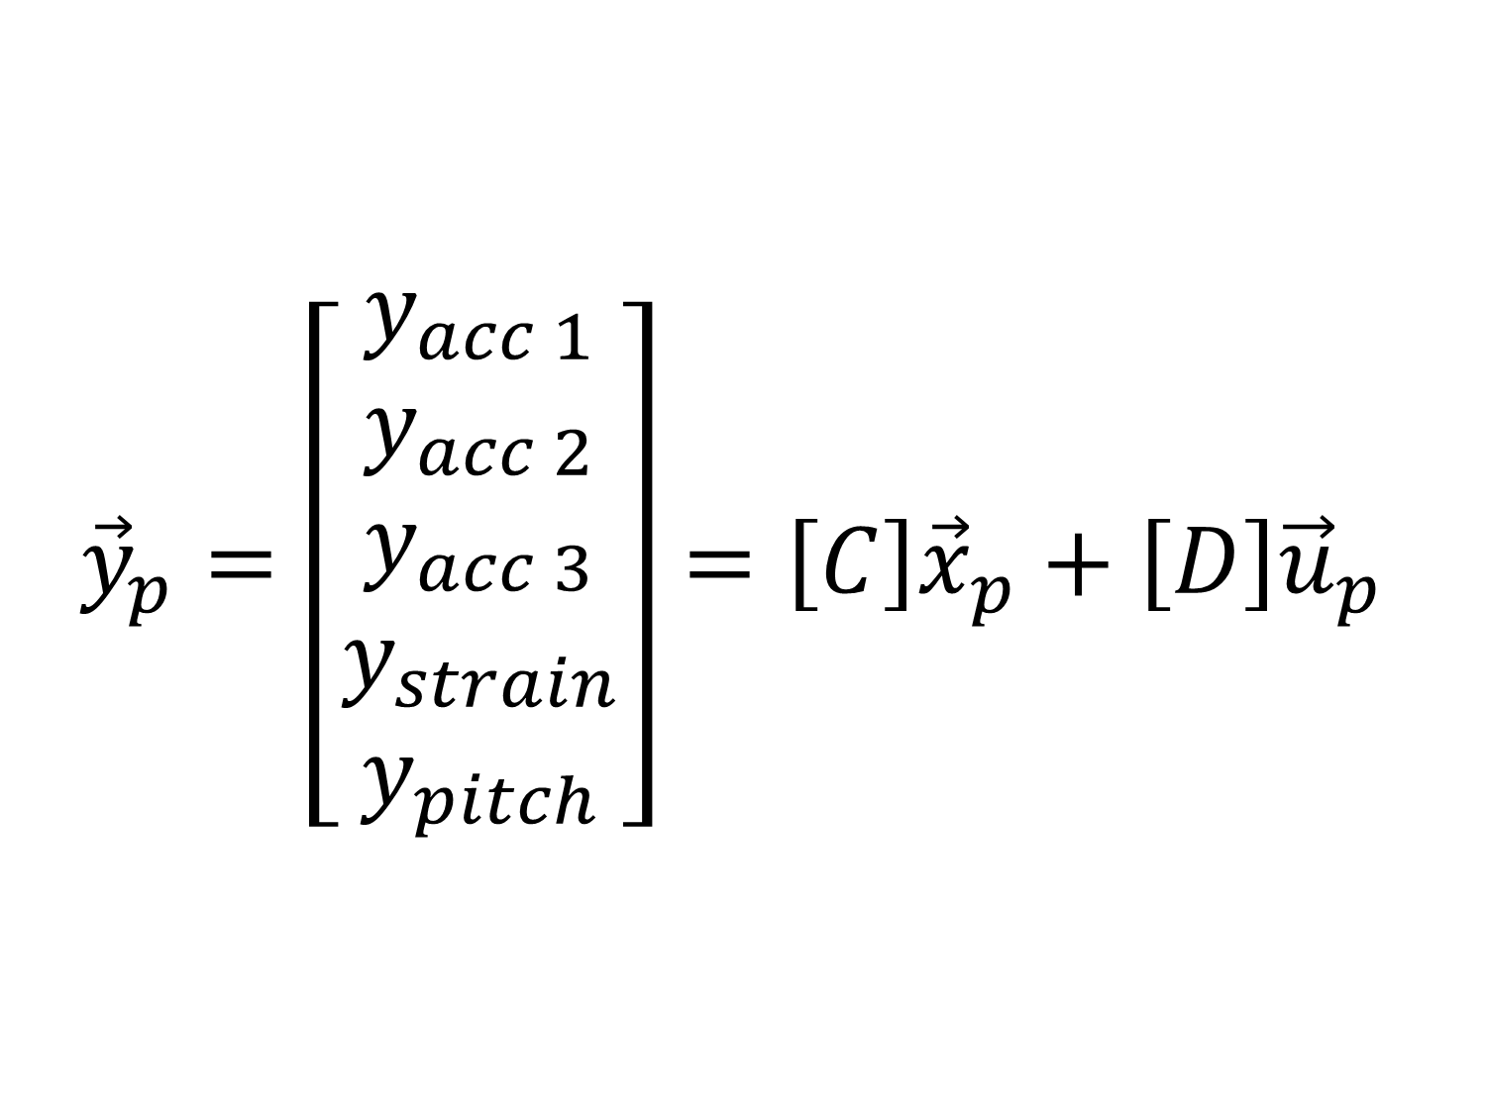
Math Model
Plant Output
$${\vec{y}}_{p}=\left[\begin{aligned}y_{acc 1} \\ y_{acc 2} \\ y_{acc 3} \\ y_{strain} \\ y_{pitch}\end{aligned}\right]=\left[C\right]{\vec{x}}_{p}+\left[D\right]{\vec{u}}_{p}$$
$\vec{q}$ corresponds to mode shapes $\left[φ\right]$ from NASTRAN
accelerometer: motion at one DOF in the mode shapes
pitch sensor: motion at one DOF in the mode shapes
$\vec{q}$ corresponds to modal load conditions (force and moment)
strain gauge: stress at one DOF in the modal loads
Euler-Bernoulli beam theory
$t=$ wing spar thickness
Notes:
<insert>

Slide 24
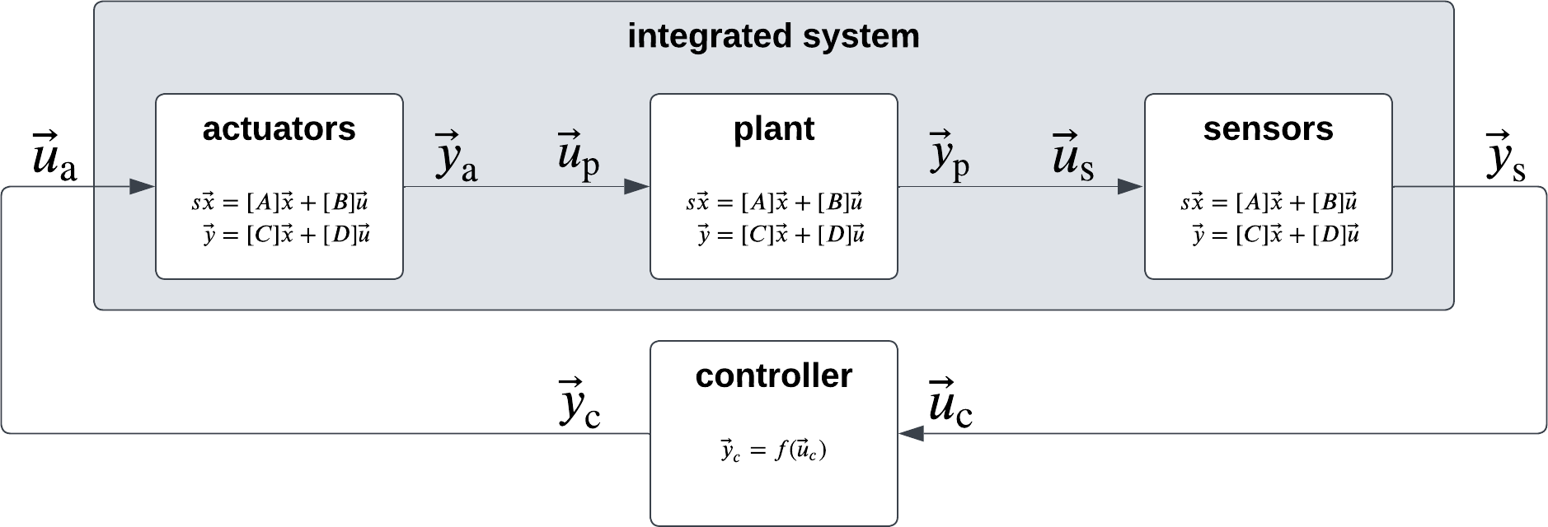
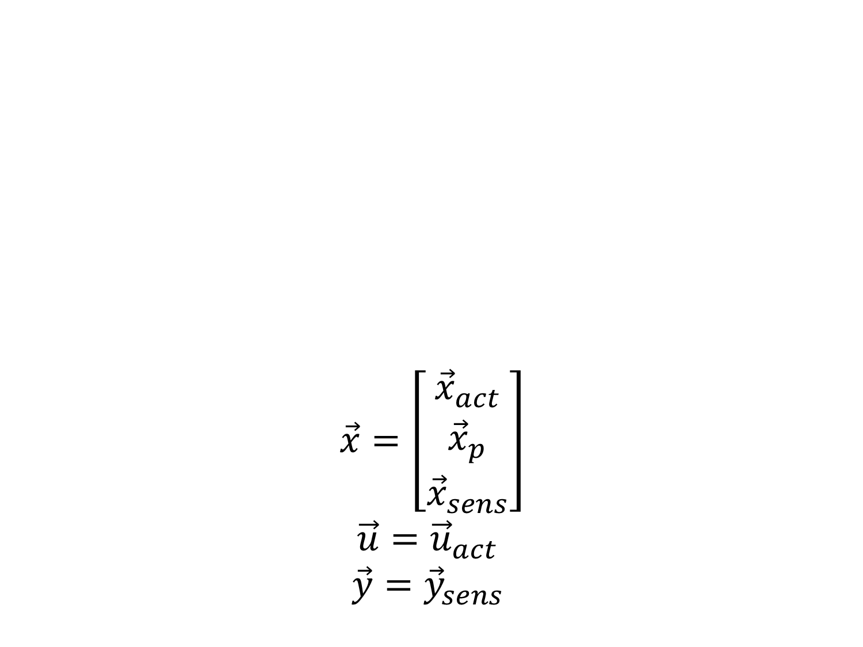
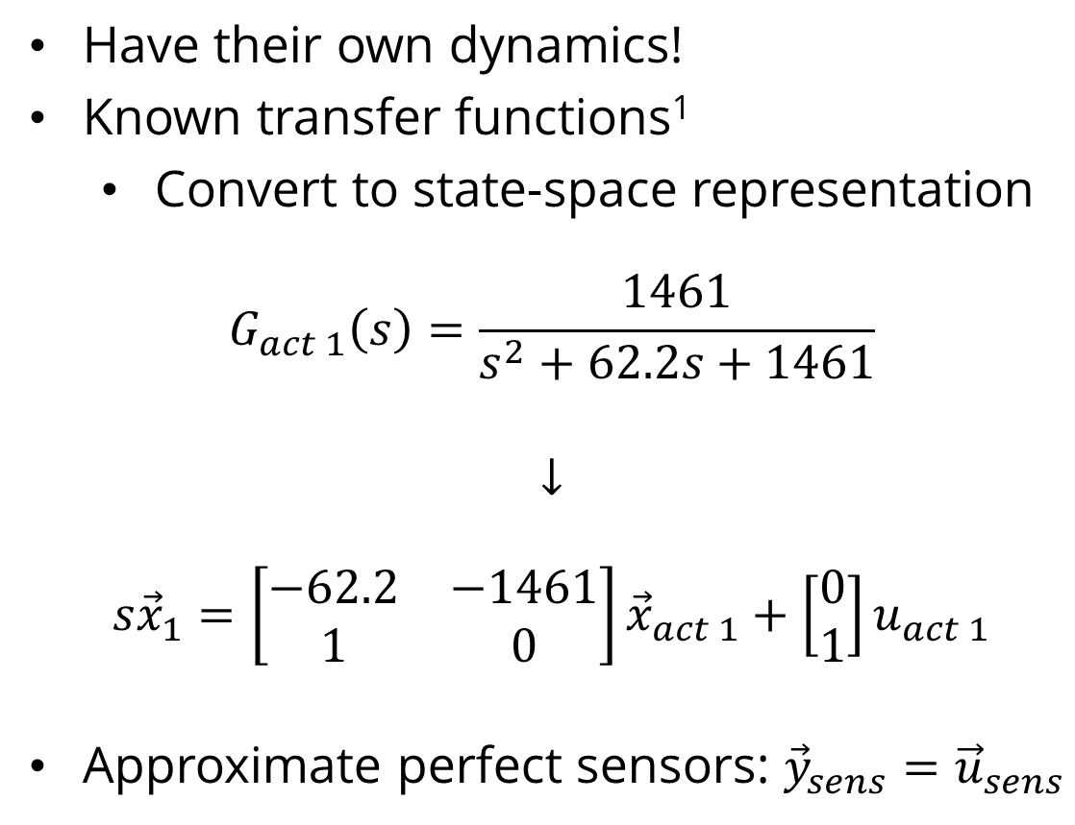
Math Model
Actuators & Sensors
$$\vec{x}=\left[\begin{aligned}{\vec{x}}_{act} \\ {\vec{x}}_{p} \\ {\vec{x}}_{sens}\end{aligned}\right]$$
$$\vec{u}={\vec{u}}_{act}$$
$$\vec{y}={\vec{y}}_{sens}$$
Have their own dynamics!
Known transfer functions¹
Convert to state-space representation
$$G_{act 1}\left(s\right)=\frac{1461}{s^{2}+62.2s+1461}$$
$$↓$$
$$s{\vec{x}}_{1}=\left[\begin{matrix}−62.2 & −1461 \\ 1 & 0\end{matrix}\right]{\vec{x}}_{act 1}+\left[\begin{aligned}0 \\ 1\end{aligned}\right]u_{act 1}$$
Approximate perfect sensors: ${\vec{y}}_{sens}={\vec{u}}_{sens}$
Coupled Aeroservoelastics
Chain together state-space models
Notes:
<insert>

Slide 25
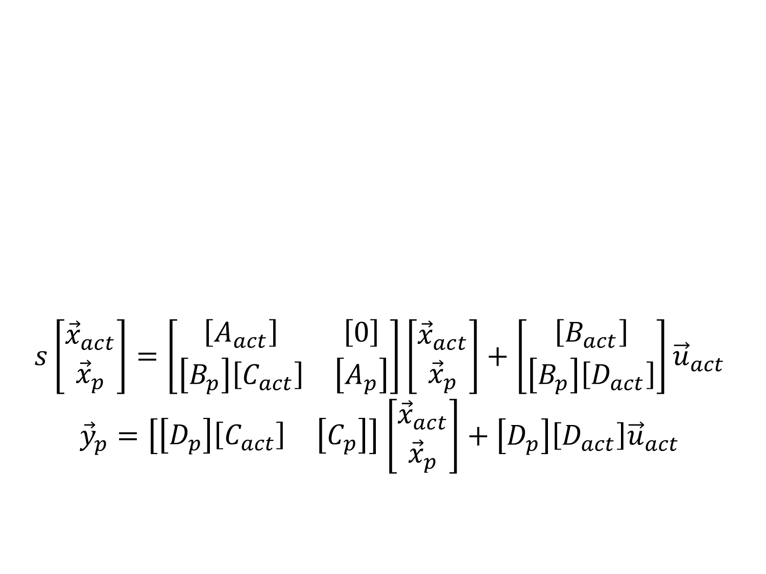
Math Model
Actuators & Sensors
$$s\left[\begin{aligned}{\vec{x}}_{act} \\ {\vec{x}}_{p}\end{aligned}\right]=\left[\begin{matrix}\left[A_{act}\right] & \left[0\right] \\ \left[B_{p}\right]\left[C_{act}\right] & \left[A_{p}\right]\end{matrix}\right]\left[\begin{aligned}{\vec{x}}_{act} \\ {\vec{x}}_{p}\end{aligned}\right]+\left[\begin{aligned}\left[B_{act}\right] \\ \left[B_{p}\right]\left[D_{act}\right]\end{aligned}\right]{\vec{u}}_{act}$$
${\vec{y}}_{p}=\left[\begin{matrix}\left[D_{p}\right]\left[C_{act}\right] & \left[C_{p}\right]\end{matrix}\right]$ $\left[\begin{aligned}{\vec{x}}_{act} \\ {\vec{x}}_{p}\end{aligned}\right]+\left[D_{p}\right]\left[D_{act}\right]{\vec{u}}_{act}$
Have their own dynamics!
Known transfer functions¹
Convert to state-space representation
$$G_{act 1}\left(s\right)=\frac{1461}{s^{2}+62.2s+1461}$$
$$↓$$
$$s{\vec{x}}_{1}=\left[\begin{matrix}−62.2 & −1461 \\ 1 & 0\end{matrix}\right]{\vec{x}}_{act 1}+\left[\begin{aligned}0 \\ 1\end{aligned}\right]u_{act 1}$$
Approximate perfect sensors: ${\vec{y}}_{sens}={\vec{u}}_{sens}$
Coupled Aeroservoelastics
Chain together state-space models
Notes:
<insert>

Slide 26
Wind Tunnel Testing
Why?
Validate mathematical model
Update mathematical model

Slide 27
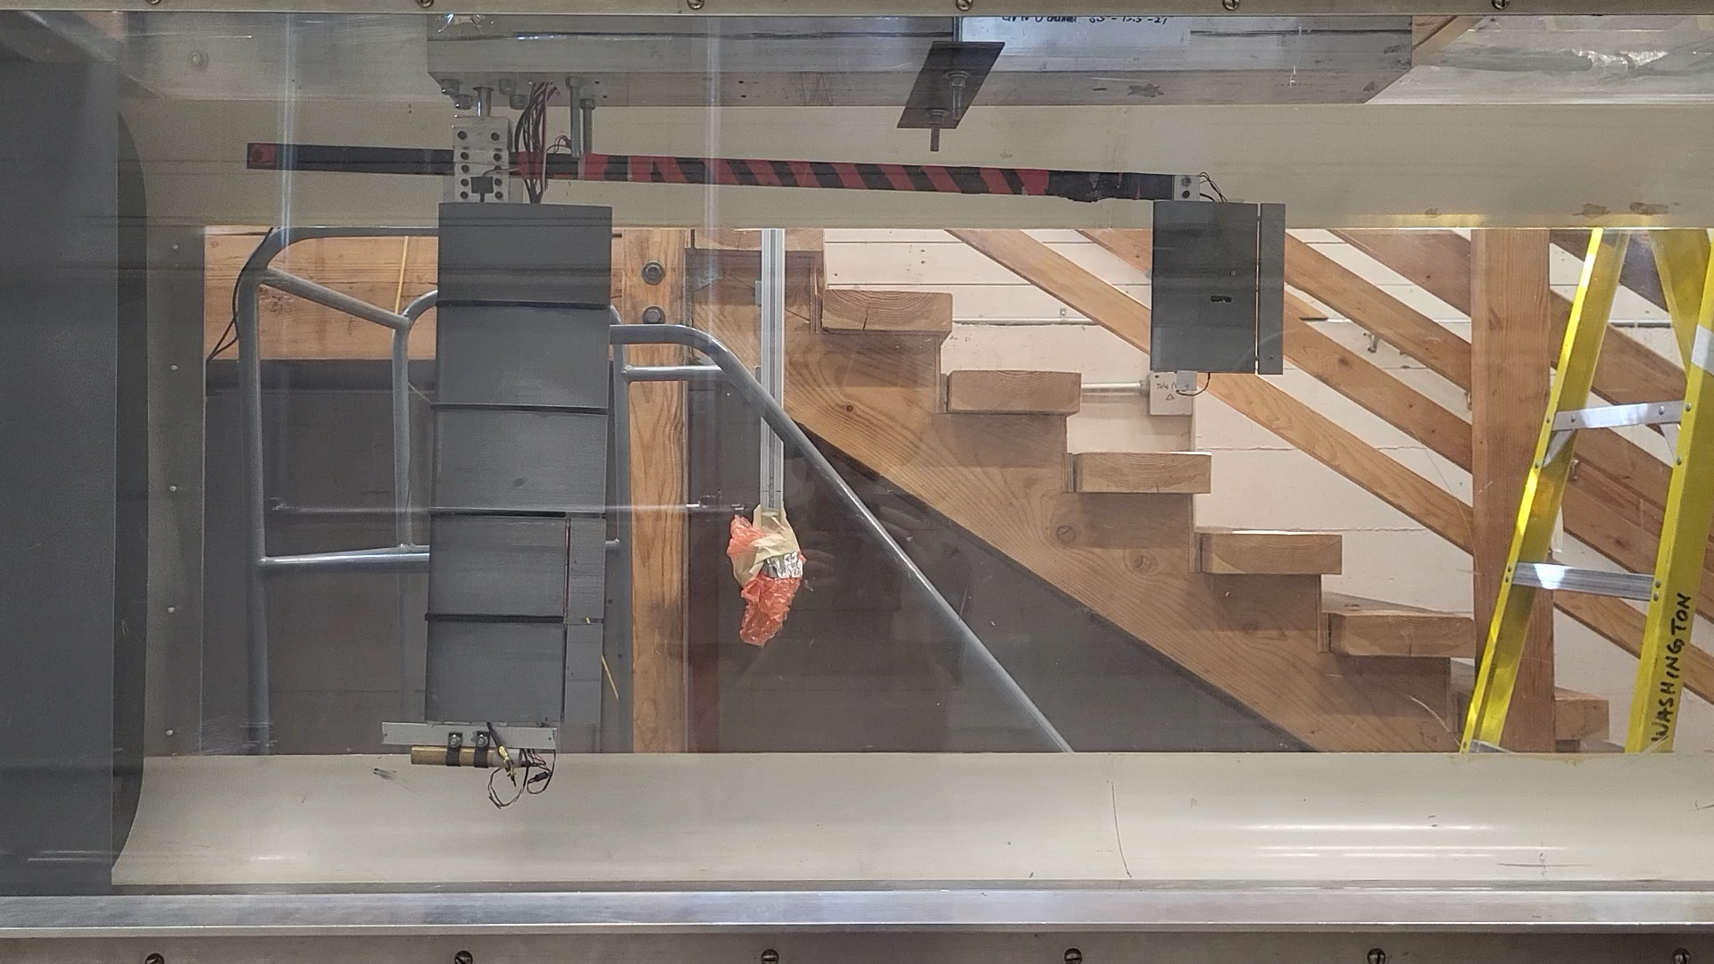
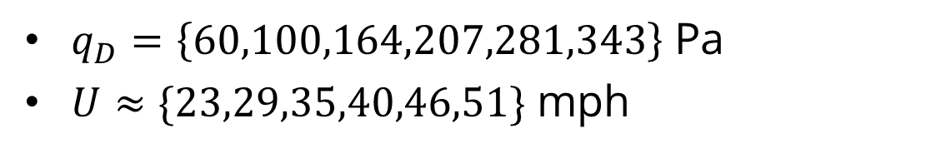
Wind Tunnel
Test Interface
Simulink Real-Time
National Instruments DAQ
Test Conditions
$q_{D}=\left\{60,100,164,207,281,343\right\}$ Pa
$U≈\{23,29,35,40,46,51\}$ mph
Test Plan
On-board control: frequency sweep
Gust vanes: doublet
Three runs for each input for each speed
Notes:
<insert>
make sure clip audio is off

Slide 28
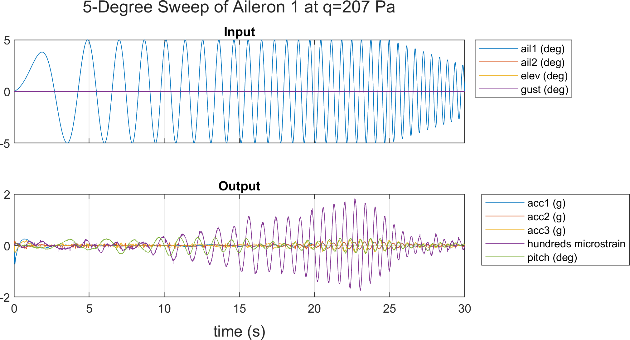
Wind Tunnel
Postprocessing
Truncation
Concatenation
Subtracting steady-state
Filtering
Bandpass filter
Transform to frequency domain
Correlation functions
Frequency response function (FRF)
Notes:
<insert>

Slide 29
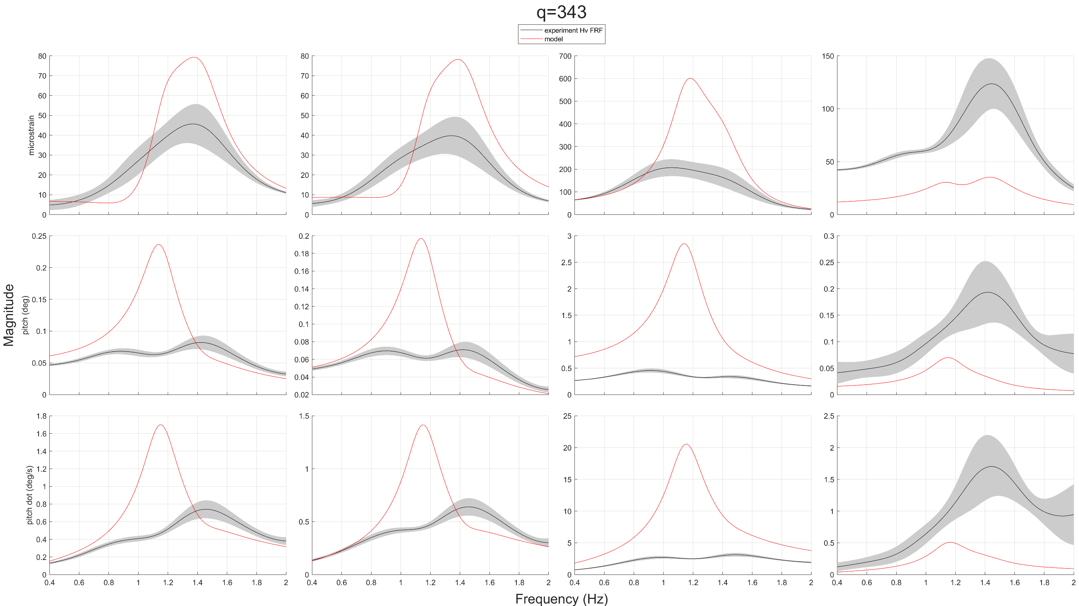
Wind Tunnel
Notes:
Aeroservoelasticity
structural dynamics, aerodynamics, and controls
important because energy-efficient aircraft have long, slender wings which are flexible
the most flexible wings must actively counteract bending and twisting in real-time
MLA, GLA, and flutter suppression
MARGE
MARGE is the test article that is modeled and tested in this project
short for Model for Aeroelastic Response to Gust Excitation
Modeling
The objective of this project was to synthesize a physics-based state-space model of MARGE
This model can then be used for control design to do the aforementioned things (MLA, GLA, flutter suppression)

Slide 30
Model Tuning
Why?
Simple model does not yet match reality

Slide 31
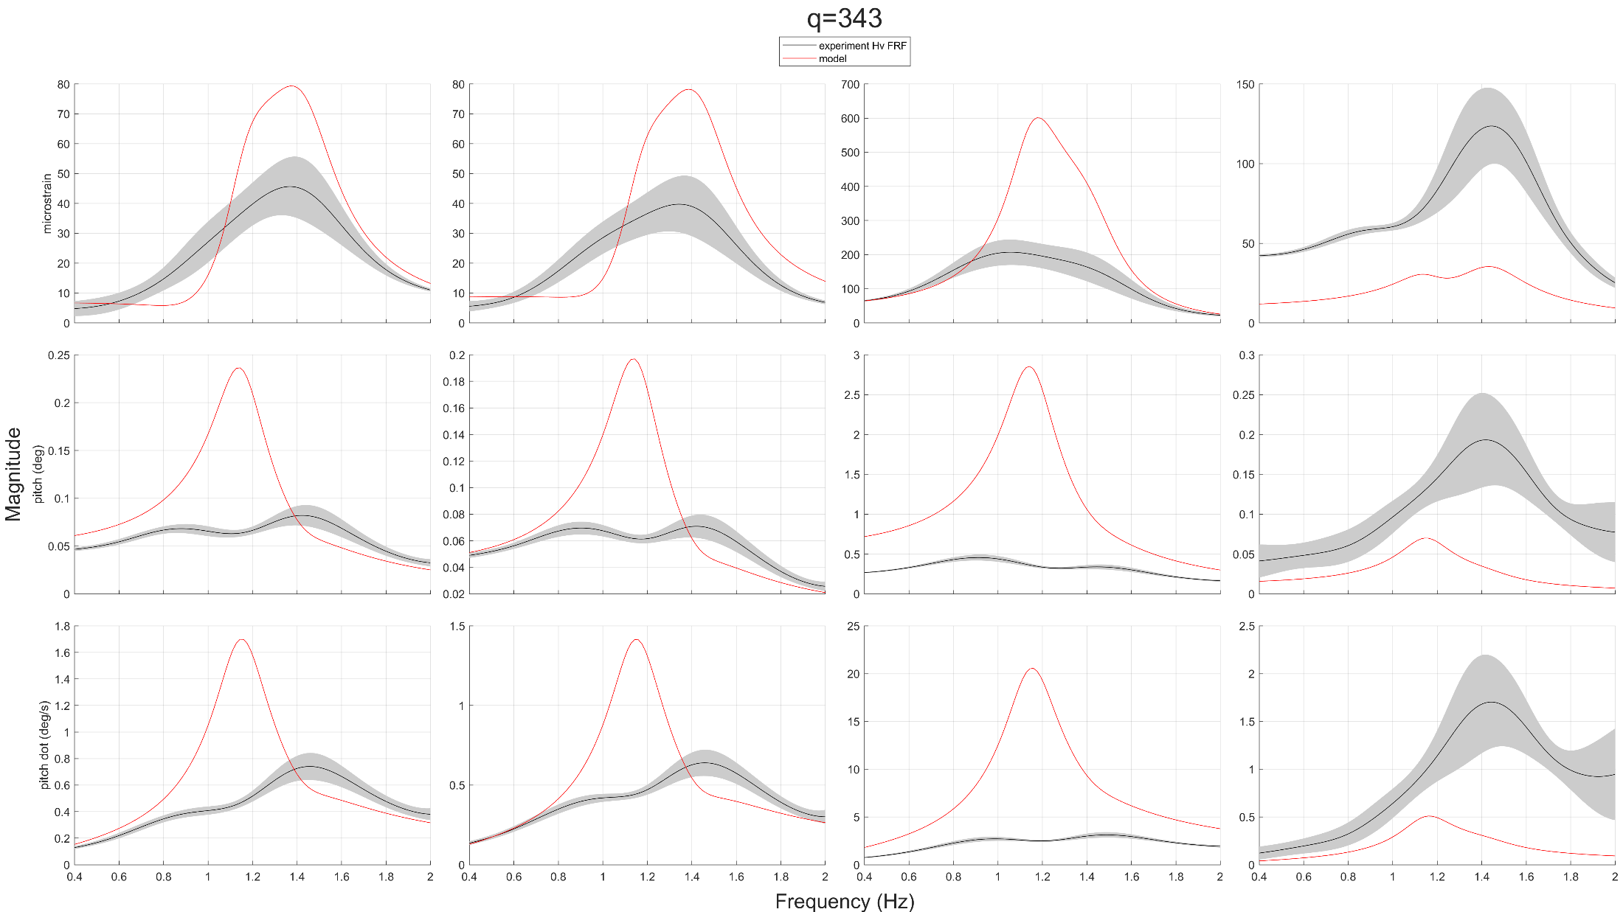
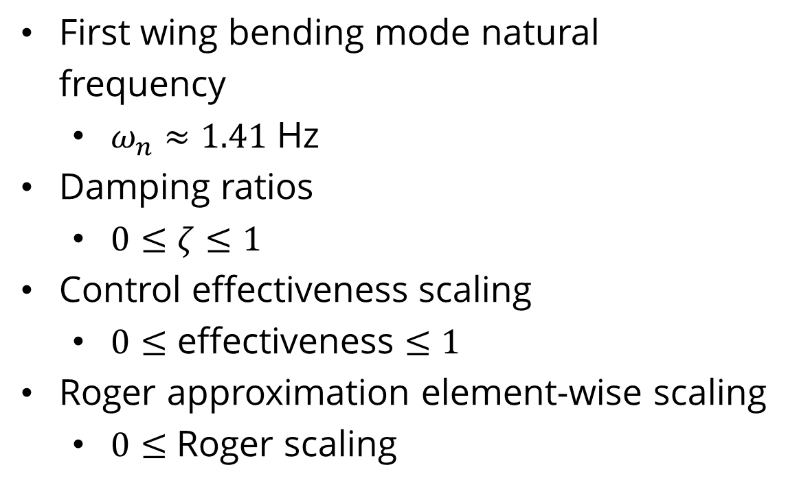
Model Tuning
Tuning Parameters
First wing bending mode natural frequency
$ω_{n}≈1.41$ Hz
Damping ratios
$0≤ζ≤1$
Control effectiveness scaling
$0≤\text{effectiveness}≤1$
Roger approximation element-wise scaling
$0≤$ Roger scaling
Notes:
<insert>

Slide 32
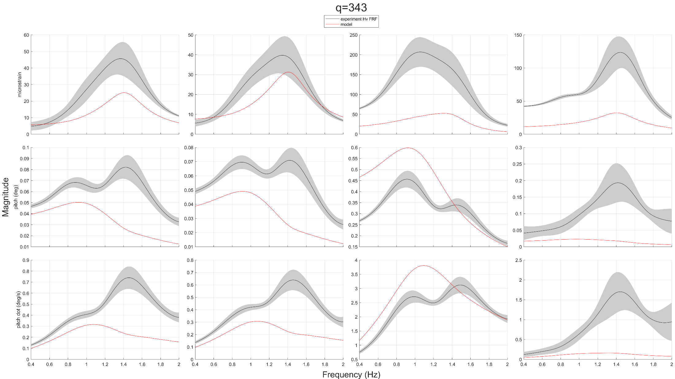
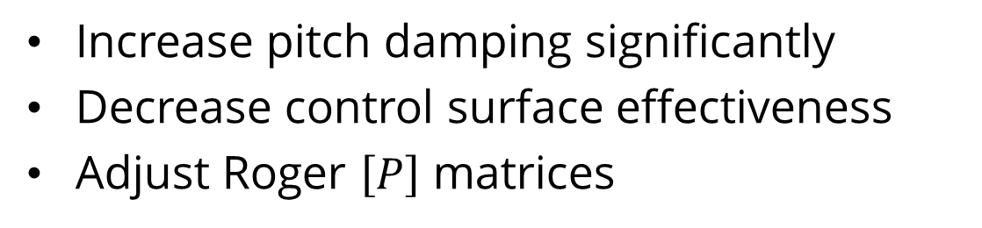
Model Tuning
Hand Tuning
Increase pitch damping significantly
Decrease control surface effectiveness
Adjust Roger $\left[P\right]$ matrices
Notes:
<insert>

Slide 33
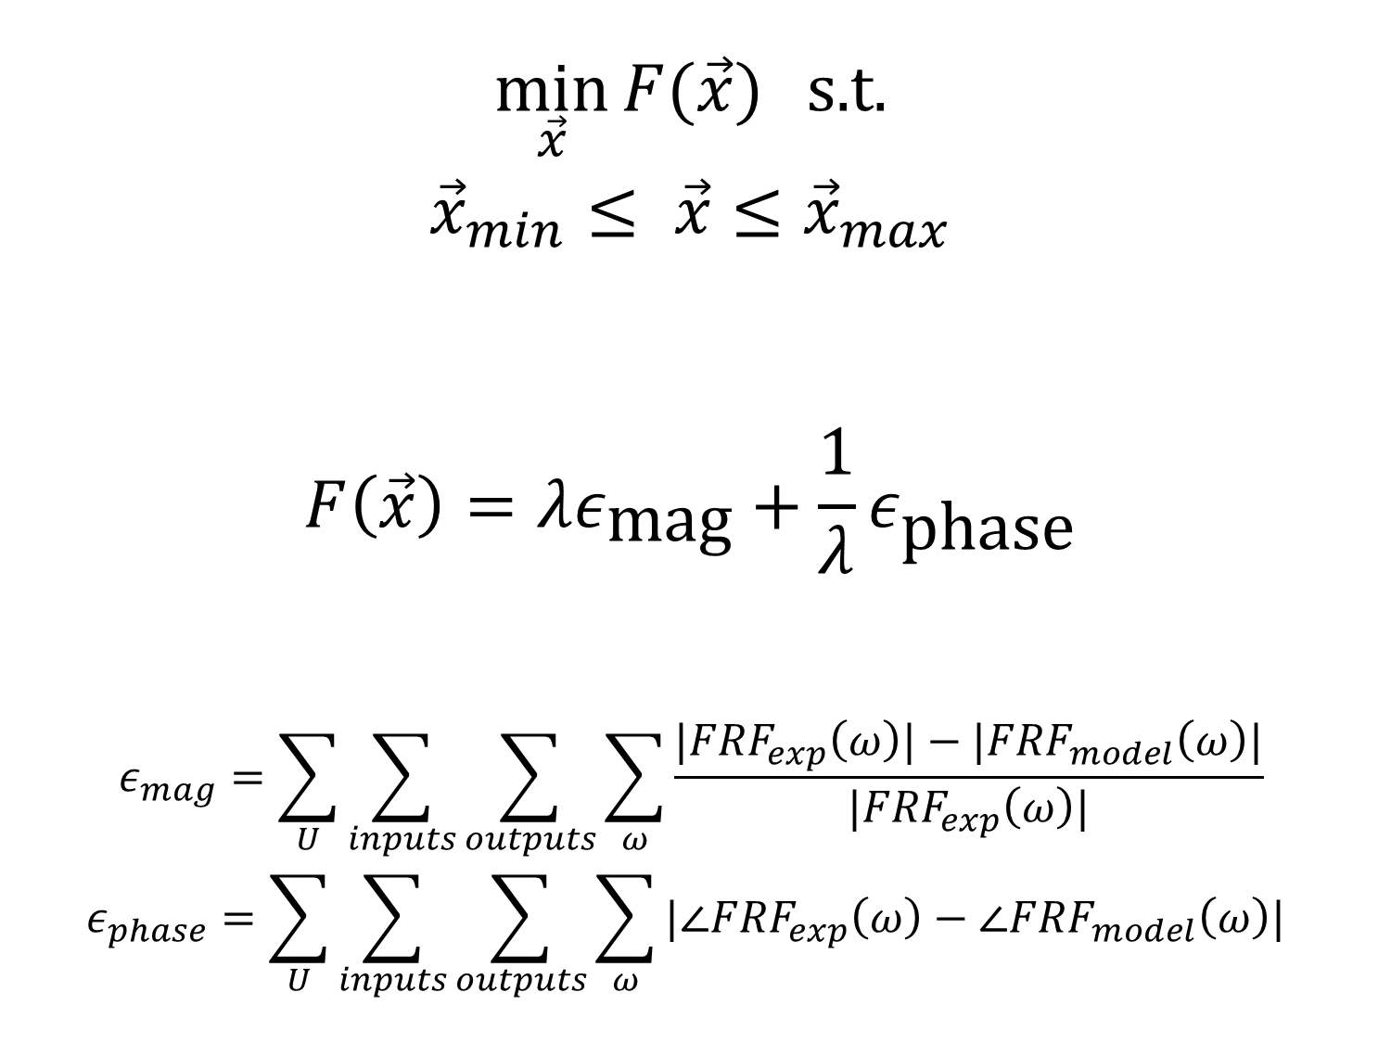
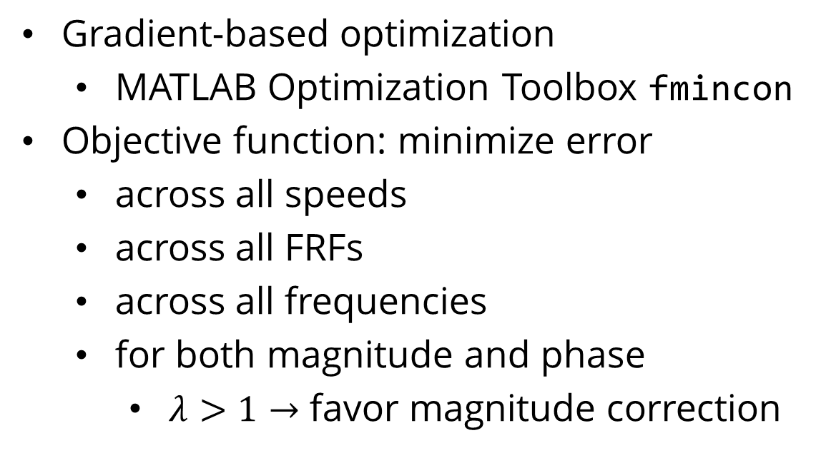
Model Tuning
Optimization
$$\min_{\vec{x}}{F(\vec{x})} \text{s}\text{.}\text{t}\text{.}$$
$${\vec{x}}_{min}≤ \vec{x}≤{\vec{x}}_{max}$$
$$F\left(\vec{x}\right)=λε_{\text{mag}}+\frac{1}{λ}ε_{\text{phase}}$$
$$ε_{mag}=\sum_{U}{\sum_{inputs}{\sum_{outputs}{\sum_{ω}{\frac{|FRF_{exp}\left(ω\right)|−|FRF_{model}\left(ω\right)|}{|FRF_{exp}\left(ω\right)|}}}}}$$
$$ε_{phase}=\sum_{U}{\sum_{inputs}{\sum_{outputs}{\sum_{ω}{|∠FRF_{exp}\left(ω\right)−∠FRF_{model}\left(ω\right)| }}}}$$
Gradient-based optimization
MATLAB Optimization Toolbox fmincon
Objective function: minimize error
across all speeds
across all FRFs
across all frequencies
for both magnitude and phase
$λ>1→$ favor magnitude correction
https://commons.wikimedia.org/wiki/File:Gradient_descent_method.png
Notes:
<insert>

Slide 34
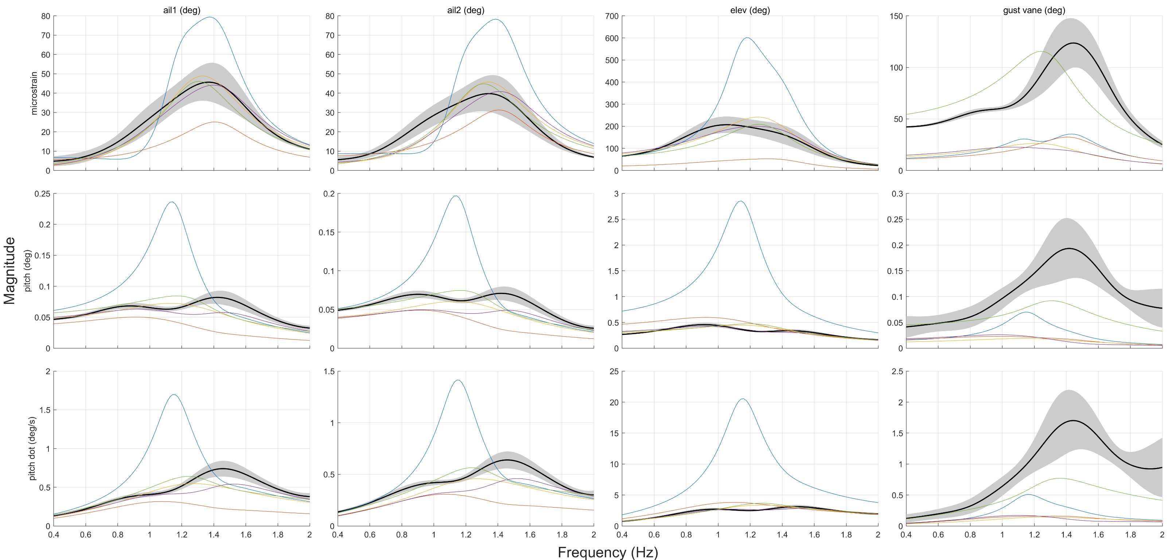
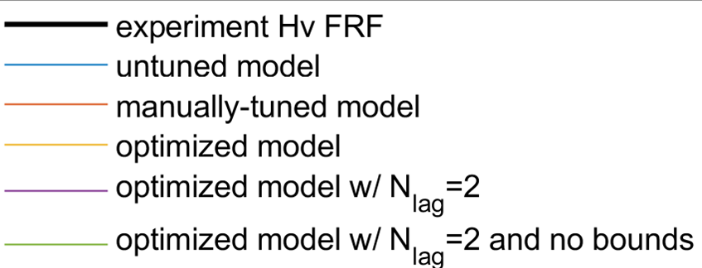
Model Tuning
Notes:
Aeroservoelasticity
structural dynamics, aerodynamics, and controls
important because energy-efficient aircraft have long, slender wings which are flexible
the most flexible wings must actively counteract bending and twisting in real-time
MLA, GLA, and flutter suppression
MARGE
MARGE is the test article that is modeled and tested in this project
short for Model for Aeroelastic Response to Gust Excitation
Modeling
The objective of this project was to synthesize a physics-based state-space model of MARGE
This model can then be used for control design to do the aforementioned things (MLA, GLA, flutter suppression)

Slide 35
Future Work
Higher Fidelity Measurement
Extend Modeling Techniques
Design and Test Control Law
Electronically shielded instrumentation
Mode shape measurement
Global optimization
Black-box system ID
Gust load alleviation
Maneuver load alleviation
Active flutter suppression
https://www.m4-engineering.com/wp-content/uploads/2020/04/pynastran-2.png
Notes:
Aeroservoelasticity
structural dynamics, aerodynamics, and controls
important because energy-efficient aircraft have long, slender wings which are flexible
the most flexible wings must actively counteract bending and twisting in real-time
MLA, GLA, and flutter suppression
MARGE
MARGE is the test article that is modeled and tested in this project
short for Model for Aeroelastic Response to Gust Excitation
Modeling
The objective of this project was to synthesize a physics-based state-space model of MARGE
Physics-based “grey-box” models are (in theory) more interpretable and generalizable than traditional black-box system identification methods
This model can then be used for control design to do the aforementioned things (MLA, GLA, flutter suppression)

Slide 36
Conclusion
Mathematical model synthesis
Experimental model validation
Applications in aircraft flight control
Notes:
acknowledgement also

Slide 37
References
[1] Jake D. Quenzer, Alison Zongolowicz, Kimberly A. Hinson, Bijan Barzgaran, Eli Livne, Mehran Mesbahi, and Kristi Morgansen. Model for Aeroelastic Response to Gust Excitation. American Institute of Aeronautics and Astronautics Inc., 2019.
[2] Mark B. Tischler and Robert K. Remple. Aircraft and Rotorcraft System Identification, chapter 7. American Institute of Aeronautics and Astronautics, Inc., 1801 Alexander Bell Drive, Reston, VA 20191-4344, 2 edition, 2006.
[3] Kenneth L. Roger. Airplane math modeling methods for active control design. In Structural Aspects of Active Controls, AGARD-CP-228, Aug 1977.

Slide 38
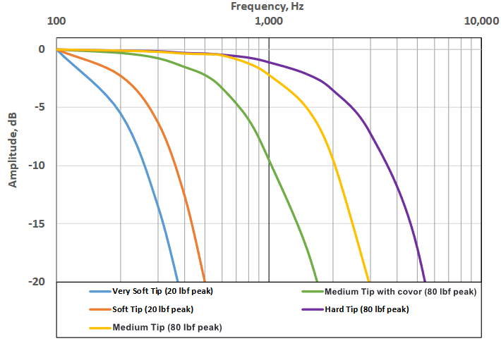

Slide 39


ENCODE
SANS

Slide 40
FONT GUIDE
Headings:
ENCODE SANS NORMAL BLACK, ALL CAPS
Alternate headlines and subheads:
UNI SANS BOOK, ALL CAPS
Bodies: Open sans and Open sans bold

Slide 41
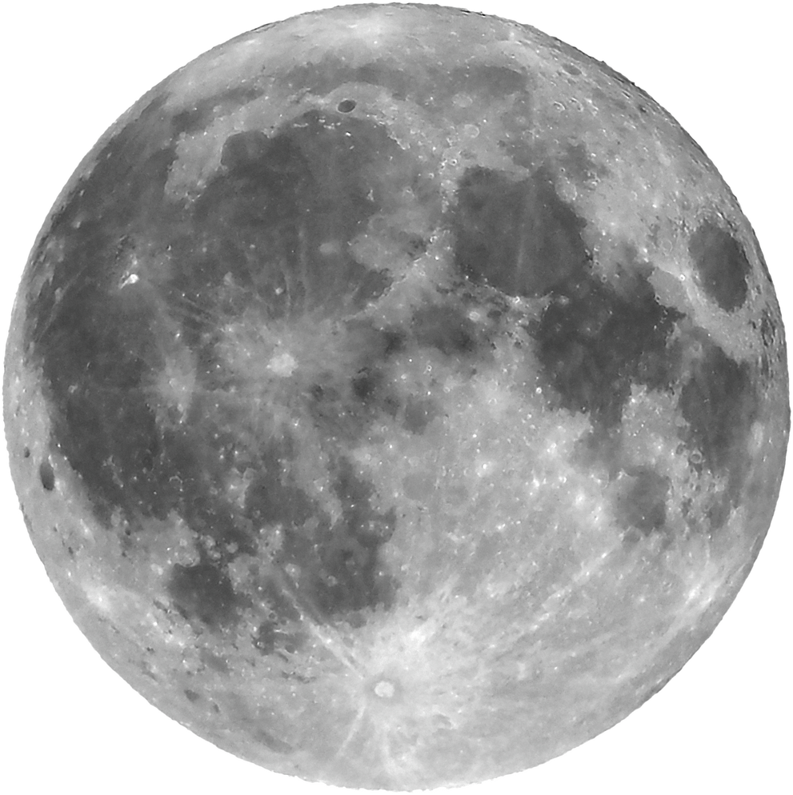
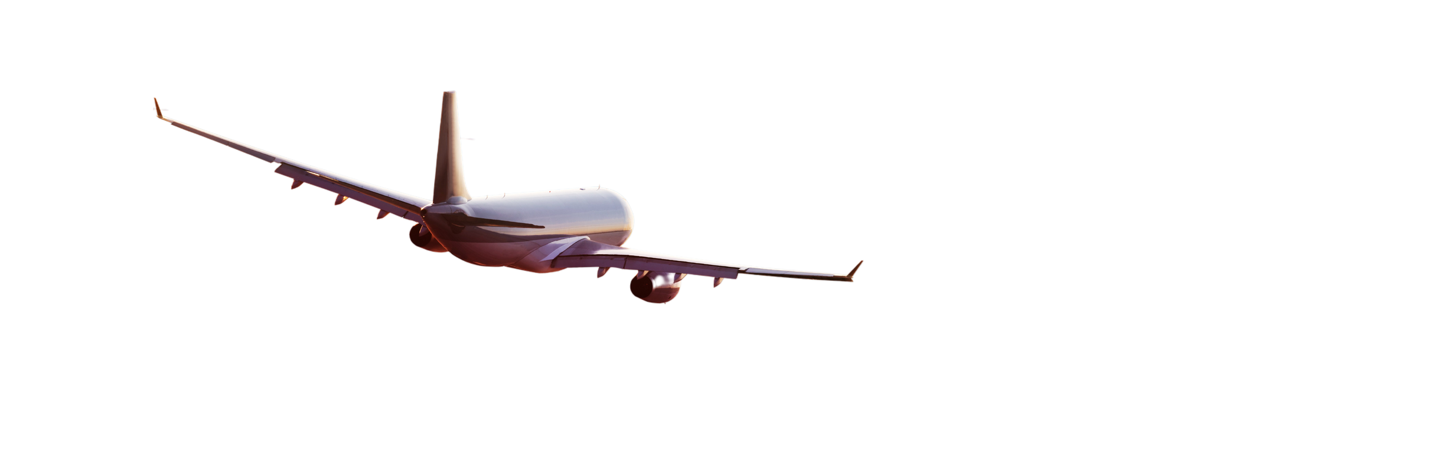
1
Open sans regular body
ENCODE
SANS
2
Or open sans bold body
UNI SANS
(SUBHEADING)

Slide 42
ENCODE SANS HEADING
UNI SANS SUBHEADING
87%
Briefly elaborate on what you want to discuss.
Briefly elaborate on what you want to discuss.

Slide 43
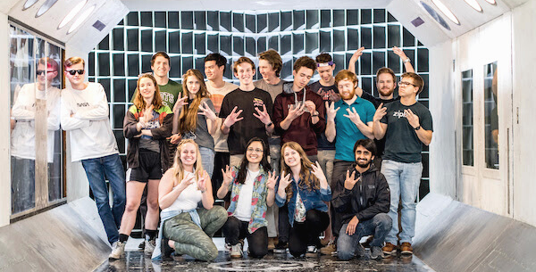


ENCODE SANS HEADING
Open sans body Open sans body Open sans body Open sans body Open sans body Open sans body Open sans body Open sans body Open sans body
1
2
3
Open sans body
Open sans body
Open sans body
Open sans body
Open sans body
Open sans body
Open sans body
Open sans body
Open sans body
Open sans body
Open sans body
Open sans body
Open sans body
Open sans body
Open sans body
Open sans body
Open sans body
Open sans body

Slide 44



ENCODE SANS HEADING
Open sans body Open sans body Open sans body Open sans body Open sans body Open sans body Open sans body Open sans body
UNI SANS
UNI SANS
UNI SANS
Open sans body Open sans body Open sans body Open sans body Open sans body Open sans body
Open sans body Open sans body Open sans body Open sans body Open sans body Open sans body
Open sans body Open sans body Open sans body Open sans body Open sans body Open sans body

Slide 45





ENCODE SANS
UNI SANS SUBHEADING
Open sans body Open sans body Open sans body Open sans body Open sans body Open sans body Open sans body Open sans body Open sans body Open sans body
Open sans body Open sans body Open sans body Open sans body Open sans body Open sans body Open sans body Open sans body Open sans body Open sans body

Slide 46
break

Slide 47

ENCODE SANS HEADING
UNI SANS SUBHEADING

Slide 48
01
UNI SANS
Open sans body Open sans body Open sans body Open sans body Open sans body Open sans body
UNI SANS
ENCODE
SANS
Open sans body Open sans body Open sans body Open sans body Open sans body Open sans body
UNI SANS
Open sans body Open sans body Open sans body Open sans body Open sans body Open sans body

Slide 49

ENCODE SANS HEADING
02
UNI SANS SUBHEADING
Open sans body Open sans body Open sans body Open sans body Open sans body Open sans body Open sans body

Slide 50


UNI SANS
Open sans body Open sans body Open sans body Open sans body Open sans body
UNI SANS
Open sans body Open sans body Open sans body Open sans body Open sans body

Slide 51

03
UNI SANS
Open sans body Open sans body Open sans body Open sans body
ENCODE SANS HEADING
UNI SANS
Open sans body Open sans body Open sans body Open sans body
UNI SANS
Open sans body Open sans body Open sans body Open sans body

Slide 52
break

Slide 53
ENCODE SANS
UNI SANS SUBHEADING
UW AERO AND ASTRO
pg 01 / 22

Slide 54
UNI SANS
UNI SANS
ENCODE SANS
Open sans
Open sans
Open sans
Open sans
Open sans
Open sans
Open sans
Open sans
Open sans
Open sans
03
07
08
09
11
13
14
15
16
17

Slide 55
UNI SANS
UNI SANS
OPEN SANS BOLD
Encode sans heading
UNI SANS SUBHEADING

Slide 56
UNI SANS
UNI SANS
OPEN SANS BOLD
Encode sans heading
UNI SANS SUBHEADING
Open sans body Open sans body Open sans body Open sans body Open sans body Open sans body Open sans body Open sans body Open sans body Open sans body Open sans body Open sans body Open sans body Open sans body Open sans body Open sans body Open sans body Open sans body

Slide 57
UNI SANS
UNI SANS
OPEN SANS BOLD
ENCODE SANS
Open sans body Open sans body Open sans body Open sans body Open sans body Open sans body Open sans body Open sans body Open sans body Open sans body Open sans body Open sans body Open sans body Open sans body Open sans body Open sans body Open sans body Open sans body Open sans body Open sans body Open sans body Open sans body Open sans body Open sans body Open sans body Open sans body Open sans body
Open sans body Open sans body Open sans body Open sans body Open sans body Open sans body Open sans body Open sans body Open sans body
ENCODE SANS
Open sans body Open sans body Open sans body Open sans body Open sans body Open sans body Open sans body Open sans body Open sans body

Slide 58
UNI SANS
UNI SANS
OPEN SANS BOLD
ENCODE SANS HEADING
UNI SANS
UNI SANS
UNI SANS

Slide 59
break

Slide 60




ENCODE SANS HEADING
UNI SANS SUBHEADING

Slide 61

ENCODE SANS
Open sans body Open sans body Open sans body Open sans body Open sans body Open sans body Open sans body Open sans body Open sans body Open sans body Open sans body Open sans body Open sans body Open sans body Open sans body Open sans body Open sans body Open sans body Open sans body Open sans body Open sans body Open sans body Open sans body Open sans body Open sans body

Slide 62


ENCODE SANS
UNI SANS SUBHEADING
Open sans body Open sans body Open sans body Open sans body Open sans body Open sans body Open sans body Open sans body Open sans body Open sans body Open sans body Open sans body Open sans body Open sans body Open sans body Open sans body Open sans body Open sans body Open sans body Open sans body Open sans body Open sans body Open sans body Open sans body Open sans body

Slide 63

ENCODE SANS
ENCODE SANS
Open sans body Open sans body Open sans body Open sans body Open sans body Open sans body Open sans body
Open sans body Open sans body Open sans body Open sans body Open sans body Open sans body Open sans body
ENCODE SANS
ENCODE SANS
Open sans body Open sans body Open sans body Open sans body Open sans body Open sans body Open sans body
Open sans body Open sans body Open sans body Open sans body Open sans body Open sans body Open sans body

Slide 64
ENCODE SANS
ENCODE SANS
ENCODE SANS
Open sans body Open sans body Open sans body Open sans body Open sans body Open sans body Open sans body
Open sans body Open sans body Open sans body Open sans body Open sans body Open sans body Open sans body
Open sans body Open sans body Open sans body Open sans body Open sans body Open sans body Open sans body

Slide 65
break

Slide 66
ENCODE SANS
UNI SANS SUBHEADING

Slide 67
UNI SANS
Open sans body Open sans body Open sans body Open sans body
Encode sans heading
UNI SANS
Open sans body Open sans body Open sans body Open sans body

Slide 68



Encode sans heading
UNI SANS
UNI SANS
UNI SANS
Open sans body Open sans body Open sans body Open sans body
Open sans body Open sans body Open sans body Open sans body
Open sans body Open sans body Open sans body Open sans body

Slide 69
Encode sans heading
01
Uni Sans
02
Uni Sans
Open sans body Open sans body Open sans
Open sans body Open sans body Open sans
03
Uni Sans
04
Uni Sans
Open sans body Open sans body Open sans
Open sans body Open sans body Open sans

Slide 70
50
40
Encode sans
30
20
Opens sans body Open sans body Open sans body
10
0
Item 1
Item 2
Item 3
Item 4
Item 5

Slide 71

Encode sans
Open sans body Open sans body

Slide 72
break

Slide 73

Encode Sans
Heading
Open sans
UNI SANS SUBHEADING
NEXT

Slide 74
OPEN SANS
01
UNI SANS
Encode sans heading
02
UNI SANS
UNI SANS SUBHEADING
03
UNI SANS
NEXT

Slide 75



Open sans
01
Open sans
UNI SANS
Open sans

Slide 76
Encode sans heading
Open sans body
Open sans body
Open sans body

Slide 77
1
2
Encode sans
Open sans body Open sans body Open sans body Open sans body. Open sans body
Open sans body Open sans body Open sans body Open sans body. Open sans body
3
4
Open sans body Open sans body Open sans body Open sans body. Open sans body
Open sans body Open sans body Open sans body Open sans body. Open sans body
NEXT

